Slide 1
How the Mountains of North America were formed
Definition: anything higher than a hill (Really usually around 2000 ft.)

Slide 2

How fold mountains are created

Slide 3
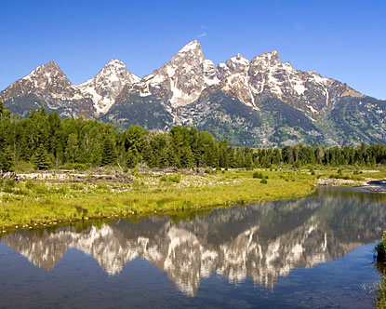
The Rocky Mountains
(an example)

Slide 4
This can be where two continental plates move towards each other or a continental and an oceanic plate.
The movement of the two plates forces sedimentary rocks upwards into a series of folds.
Fold mountains are usually formed from sedimentary rocks and are usually found along the edges continents.

Slide 5
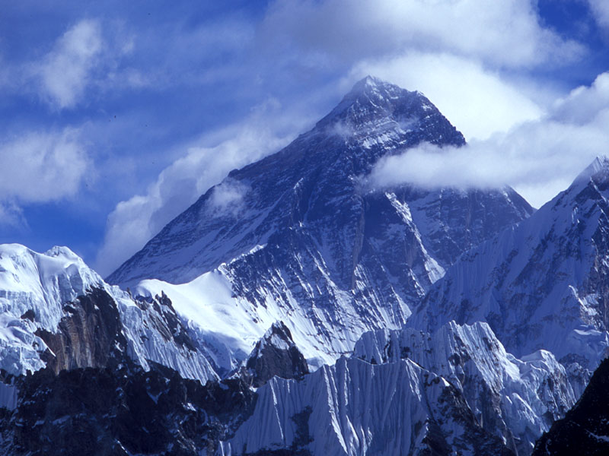
Mt. Everest is a fold Mountain that is getting taller and taller. Eventually it will get too tall and fall over.

