Slide 1
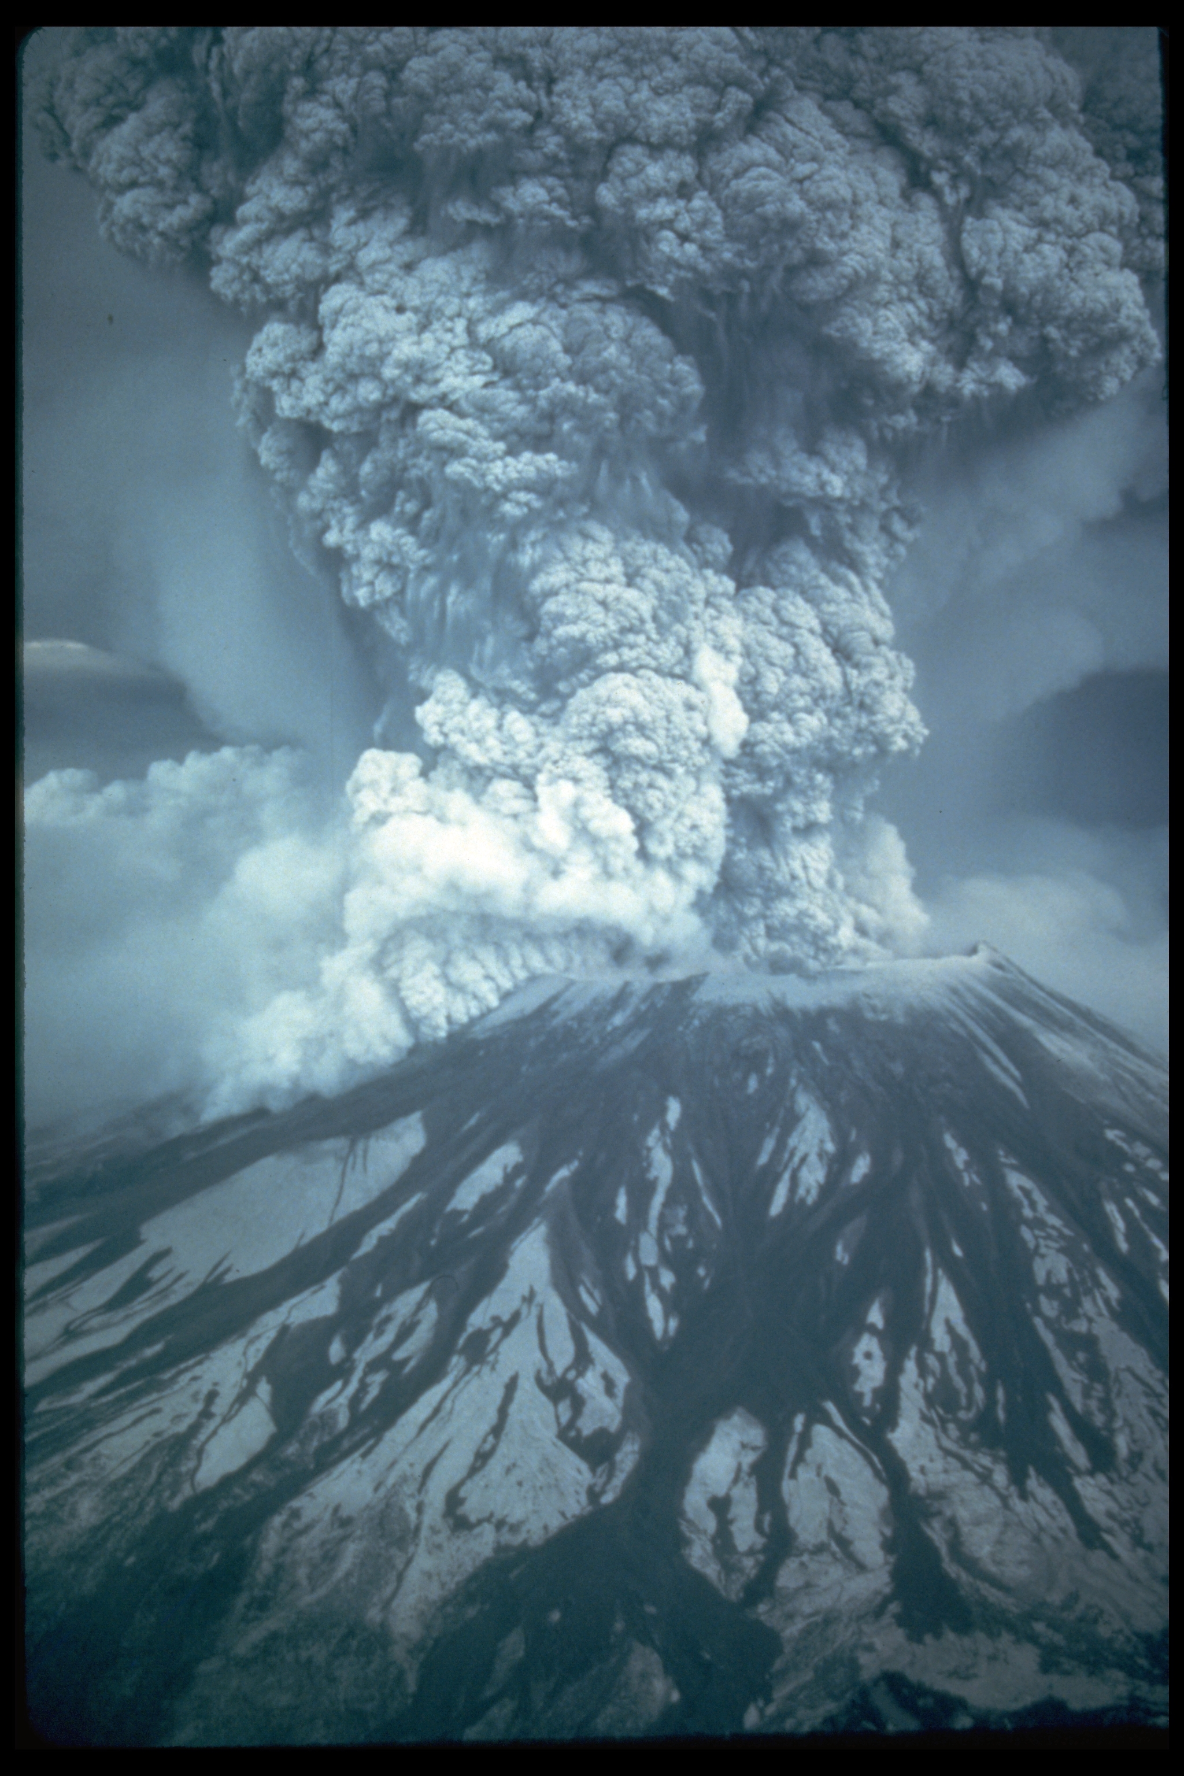
Volcanic Mountains

Slide 2
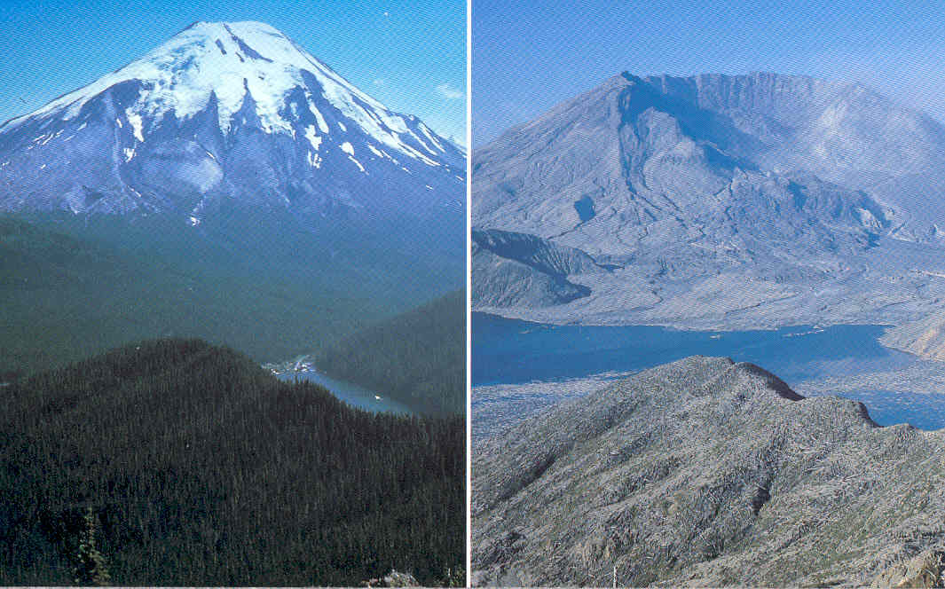
Mount St Helens. May 20, 1980 Before and After

Slide 3
Volcanic Mountains are formed when molten rock (magma) deep within the earth, erupts, and piles upon the surface. Magna is called lava when it breaks through the earth's crust. When the ash and lava cools, it builds a cone of rock.
Volcanic eruptions can create islands in the middle of the sea.
This can happen in one big event or over thousands of years with many events.

Slide 4
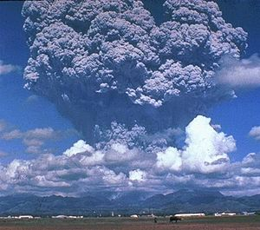
Pinatubo ash plume reaching a height of 19 km, 3 days before the climactic eruption of 15 June 1991

Slide 5
Mt. Vesuvius, Pompeii Italy

Slide 6
Old Faithful. Yellowstone

