Slide 1
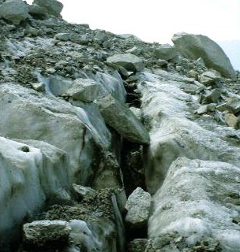
Glacier Eroding Mountains

Slide 2
Glaciers not only transport material as they move, but they also sculpt and carve away the land beneath them.
A glacier's weight, combined with its gradual movement, can drastically reshape the landscape over hundreds or even thousands of years.
The ice erodes the land surface and carries the broken rocks and soil debris far from their original places, resulting in some interesting glacial landforms.

Slide 3
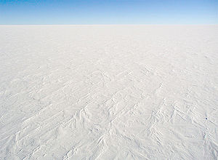
Ice Age: Wore Down Mountains and Created the Prairies

Slide 4
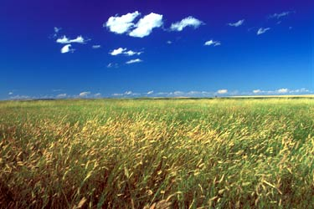
Prairies caused by dams of glacier silts that clogged up lakes. Eventually they dried out

Slide 5
Terms to know (please copy down)
Topography: What the land looks like
Climate: Temperature and amount (or lack of) precipitation
Vegetation: What grows there (naturally)

