Slide 1
First Battle of the Marne

Slide 2
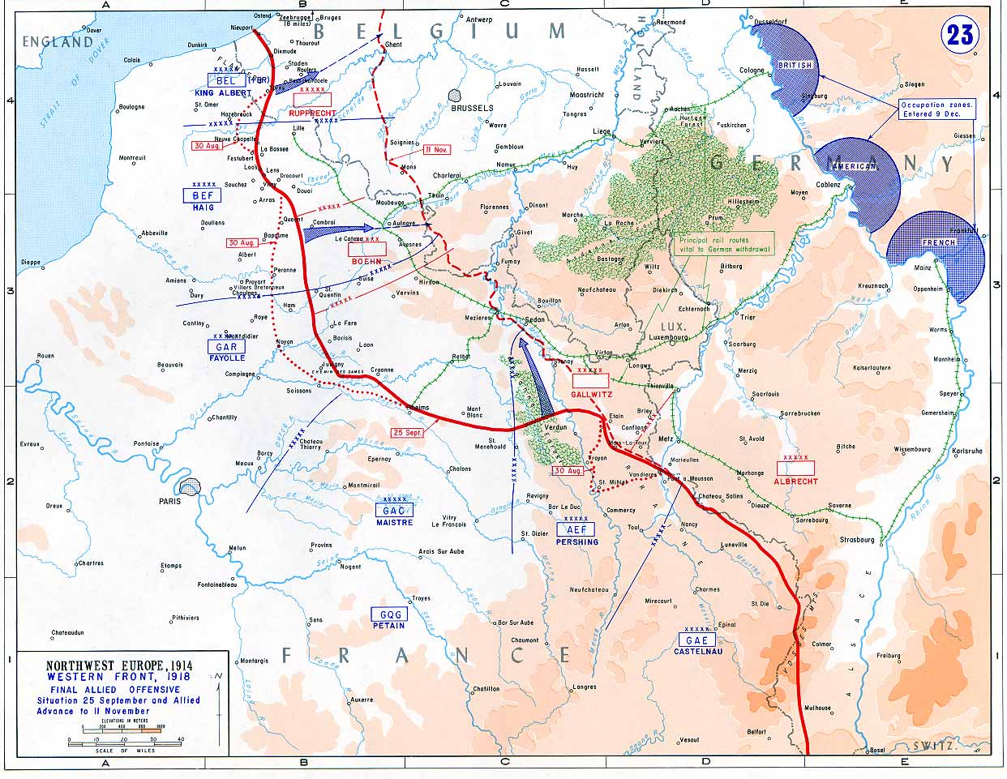
Location of the battle pointed out on the map

Slide 3
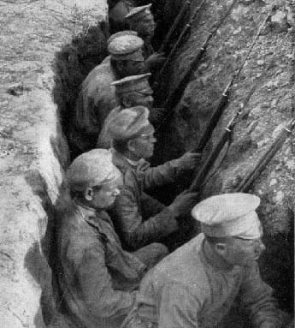
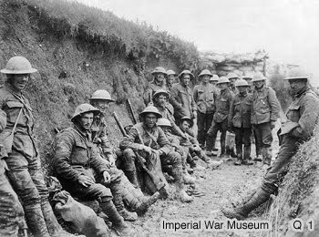
Pictures of the battle

Slide 4
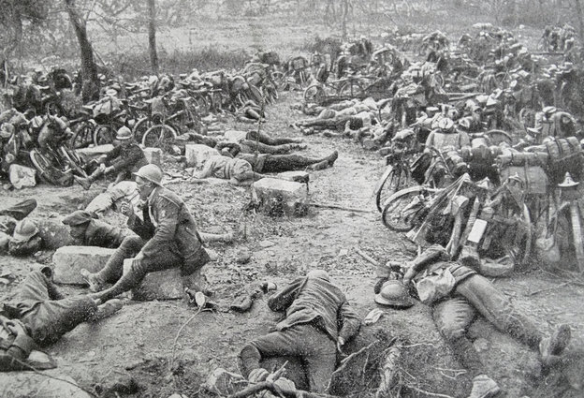
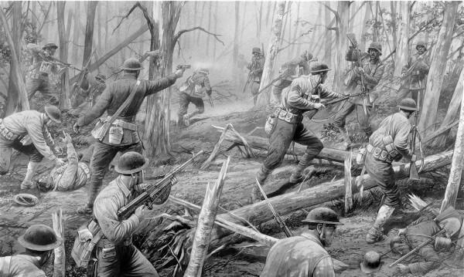
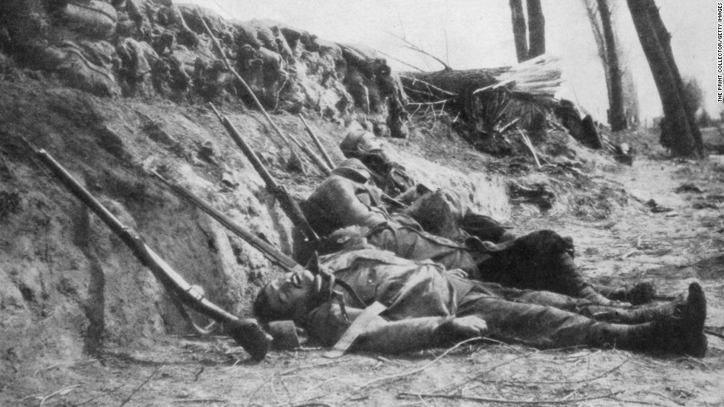

Slide 5
Outline of the battle events
The World War I First Battle of the Marne featured the first use of radio intercepts and automotive transport of troops in wartime. After French commander in chief Joseph Joffre ordered an offensive in September 1914, General Michel-Joseph Maunoury ’s French Sixth Army opened a gap between Germany’s First and Second Armies. Maunoury exploited the gap with help from the French Fifth Army and British Expeditionary Force, while Army thwarted the advances of the German Second and Third Armies. By Sept. 10, the Germans embarked on a retreat , beginning a phase of the war that would be marked by trench warfare.

Slide 6
Significant events
By early September, one month after the outbreak of war, the German army had advanced deep into northeastern France, Paris was preparing , and the French troops were exhausted from their 10–12 day retreat to the south of the Marne River. The French commander in chief, General Joseph Joffre, decided to risk a counterattack. The French 6th Army under General Michel-Joseph Maunoury attacked the flank of the German general Alexander Kluck’s 1st Army on the morning of September 6. When Kluck turned to oppose them, a 30-mile-wide gap was opened between his troops and the German 2nd Army. The Allies immediately exploited this gap by sending in the French 5th Army and troops of the British Expeditionary Force. On September 7 and 8, Maunoury’s forces were forced by 6,000 men who were transported to the battle from Paris by 600 taxis, the first automotive transport of troops in the history of war. On September 8 General Franchet d’Espery’s 5th Army made a surprise night attack on the German 2nd Army and widened the gap.

Slide 7
Reasons for success or failure of the battle
The two sides have errors:
Germany generals away from the battlefield, the front line of combat situation is unknown, improper command, the lack of coordination of the Army, leading to speed plan bankruptcy.
French generals and English generals overall combat, spotted the opportunity to look for opportunities to break through.

Slide 8
Significance of the battle in terms of the overall war
The Allied check of the German advance during the Battle of the Marne made the struggle one of the most decisive battles in history. Events at the Marne signaled the demise of Germany’s aggressive two-front war strategy, known as the Schlieffen Plan. As the historian Barbara Tuchman wrote as a conclusion to her book The Guns of August (1962): “The Battle of the Marne was one of the decisive battles of the world not because it determined that Germany would eventually lose or the Allies ultimately win the war but because it determined that the war would go on.”

Slide 9
Highlight of Canada’s contribution
NO information about the highlight of Canada’s contribution.
Because the Canadians didn’t jion this battle,so we have no recording.
The Canadians will jion the WWII.

Slide 10
Cost:equipment and men
-The first battle began on September 4, 1914, British and French troops withdrew the Marne River. September 5 to 12, the British and French troops to 6 Army 66 divisions of about 108 million people across the board counterattack.In this battle, the German casualties of about 21 million people, about 14 million French troops.
-The second battle began in July 15, 1918, the German army to three army forces in the Ma Enhe prominent areas of the British and French forces to attack.The German loss of 12 million; coalition forces lost nearly 6 million people.

Slide 11
Include some sort of interactive element
The Battle of Marne led to the failure of the Germans to encircle the French Army, and the German strategic bankruptcy in the Western Front. Chief of Staff Mao Ch'i was dismissed by King Wilhelm .

Slide 12
There is a video for here
https://www.youtube.com/watch?v=r1gqXlkJpXU

