Slide 1
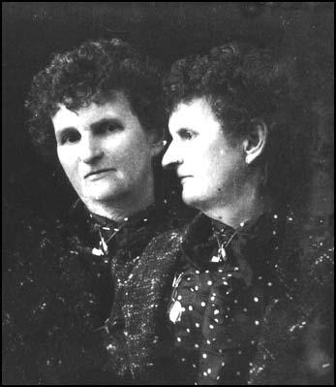
Hannah Maynard

Slide 2
Hannah Maynard led a rich and colourful life. Born Hannah Hatherly in 1832, she married bootmaker Richard Maynard in 1852 and moved to Bowmanville Ontario. In 1862 the Maynards moved to Victoria with their four children. Richard opened a boot shop and Hannah opened a photography studio. Hannah soon became a very popular photographer in the city. The bulk of her work was in portraits, but she was also involved in more experimental forms of photography such as multiple exposures and photosculptures. After the untimely deaths of two of her children, Hannah’s work became decidedly more unorthodox. Hannah Maynard died in 1918 and is buried in Victoria’s famous Ross Bay Cemetery.

Slide 3
http://www.openschool.bc.ca/courses/ss10/victorian/files/media/hannah/hannah.htm

