Slide 1
INDIAN HORSE
Novel Study/ Lit Circle Unit

Slide 2
Lit Circles – OVERVIEW
You will read ‘Indian Horse’
Once per week you will be an active participant in a Lit Circle discussing the assigned chapters (Thurs/Friday depending on which is the last of the week).
When not in your lit circle, you will be reading your novel and completing double entry journals, answering chapter questions, doing your interview assignment, and watching the video.
In this unit you will be evaluated on:
Your double entry journals
Your active participation in lit circles
Your completion of the chapter question booklet.
Your final essay.
Your Project (January)

Slide 3
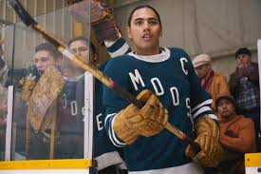
Double Entry
Journals

Slide 4
Double Entry Journals Plan and Practice
Take a piece of lined paper and fold it down the middle
Label the left side “Quotations and the right side “Responses.”
Quotations
Responses

Slide 5
Double Entry Journal Plan and Practice
We will use this strategy during our lit circles, but first we need to practice what it looks like…

Slide 6
Double Entry Journal STATEMENT / RESPONSE STARTERS
I noticed…
It upset me when…
I wonder about…
I don’t really understand…
I now understand…
If I were_____ I would…
I predict that…
I was shocked when/by…
I question…
I think…
I wish…
My reaction to this is…
This is significant to me because…
This images created in my mind from this are…
This part reminds me of…
It seems to me…
I liked the idea that…
I completely disagree with…
I felt…
In my opinion…
I know someone like…
When this happens to me, I feel…
One time I…
It was/was not fair when…
The author could have…
This was a strong quotation to me because…
What impressed me about this was…

Slide 7
Walking Both Sides of an Invisible Border
Alootook Ipellie
It is never easy
Walking with an invisible border
Separating my left and right foot
I feel like an illegitimate child
Forsaken by my parents
At least I can claim innocence
Since I did not ask to come
Into this world
Walking on both sides of this
Invisible border
Each and every day
And for the rest of my life
Is like having been
Sentenced to a torture chamber
Without having committed a crime
Understanding the history of humanity
I am not the least surprised
This is happening to me
A non-entity
During this population explosion
In a minuscule world
I did not ask to be born an Inuk
Nor did I ask to be forced
To learn an alien culture
With an alien language
But I lucked out on fate
Which I am unable to do
I have resorted to fancy dancing
In order to survive each day
No wonder I have earned
The dubious reputation of being
The world’s premier choreographer
Of distinctive dance steps
That allow me to avoid
Potential personal paranoia
On both sides of this invisible border
Sometimes this border becomes so wide
That I am unable to take another step
My feet being too far apart
When my crotch begins to tear apart
I am forced to invent
A brand new dance step
The premier choreographer
Saving the day once more
Destiny acted itself out
Deciding for me where I would come from
And what I would become
So I am left to fend for myself
Walking in two different worlds
Trying my best to make sense
Of two opposing cultures
Which are unable to integrate
Lest they swallow one another whole
Each and every day
Is a fighting day
A war of raw nerves
And to show for my efforts
I have a fair share of wins
and losses
When will all this end
This senseless battle
Between my left and right foot
When will the invisible border
Cease to be

Slide 8
What should my journal entry look like?
1) A properly sourced quote or paraphrase on the left.
2) A 3+ sentence response on the right. It should be:
3+ sentences
Show deeper thinking. Not a summary. (ex. What connections can you make to this quote?)

Slide 9
Lets Share!
Did you notice that everyone picked different sections of the poem?
Did you notice how our thoughts can be very different from others’?
Did you notice how our own thinking & understanding are enriched by others’
Meaning and importance lies in the mind of the reader

Slide 10
I am being evaluated on my double entry journals….YIKES!!
You’ve had some practice creating a double entry journal…
Let’s look at the criteria that you will be marked on at the end of the unit…

Slide 11
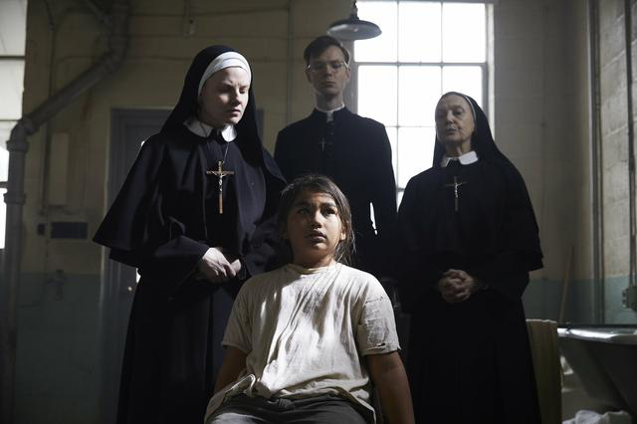
Lit Circle Discussions

Slide 12
Lit Circle Discussions: How do they Work?
Divide into groups of 5
Chose one student to go first. They will read one of their journal entries.
The person to their left will respond or add to the comment. You are allowed to disagree but please respect the opinion that has been shared.
Then the next person to the left will do the same.
This will continue until the whole circle has participated.
If you have not filled the five minutes when you finish, either repeat the circle or continue the conversation in a more relaxed way.
Remember: Listening is as important as sharing

Slide 13
Criteria For Effective Group Discussion
All voices must be included
All students must feel included
All students must have their ideas respected
The discussion should move us to new understandings
Stay on topic
Listening is as important as sharing

