Slide 1
What Would YOU Do?
An ethical dilemma

Slide 2
Ponder this…
A pregnant woman leading a group of people out of a cave on a coast is stuck in the mouth of that cave. In a short time high tide will be upon them, and unless she is unstuck, they will all be drowned except the woman, whose head is out of the cave. Fortunately, (or unfortunately,) someone has with him a stick of dynamite. There seems no way to get the pregnant woman loose without using the dynamite which will inevitably kill her; but if they do not use it everyone will drown. What should they do?
Read more at http://examples.yourdictionary.com/ethical-dilemma-examples.html#6UOjPVQ4huGyuEgr.99

Slide 3
Now answer the following question without saying a word...

Slide 4
USE THE DYNAMITE
SAVE THE
UNBORN CHILD
WITH THE KNOWLEDGE that using the dynamite will kill the pregnant woman but save the others, you believe that the group should use the dynamite
STAND UP (WITHOUT SAYING A WORD) AND STAND ON THE LEFT SIDE OF THE ROOM (YOUR LEFT, NOT MINE!)
WITH THE KNOWLEDGE that not using the dynamite and allowing the pregnant lady and her unborn child to live while the rest of the group dies you believe that the group should not use the dynamine
STAND UP (WITHOUT SAYING A WORD) AND STAND ON THE RIGHT SIDE OF THE ROOM (YOUR RIGHT, NOT MINE!)

Slide 5
NOW, partner up with someone from the opposite side of the room and CHANGE THEIR MIND...

Slide 6
TRUE ETHICAL DILEMMA
Two or more courses of actions that are ethically justifiable.

Slide 7
USE THE DYNAMITE
The greater good is more important and more lives will be saved with the dynamite
The impact will be lessened by the death of only one person, unless you consider the unborn a person (this is a whole other ethical dilemma)
There is a slim chance that the woman could survive the blast
WHY IS THIS THE ETHICALLY RIGHT THING TO DO?

Slide 8
SAVE THE
UNBORN CHILD
The adults have already experienced life and living
The child is innocent
The woman did nothing wrong
Who knows what potential might exist within that child? Perhaps he will discover the cure to cancer?
WHY IS THIS THE ETHICALLY RIGHT THING TO DO?

Slide 9
LEGALLY SPEAKING
Using the dynamite knowing that it will harm the woman and her child is murder in the first degree or second degree depending on her condition after the explosion.
According to the law, the families of the people who die from drowning have the right to sue the woman for wrongful death.
THE LAW SAYS:

Slide 10
SO what is the LEGAL thing to do?

Slide 11
LAW
ETHICS
MINIMAL STANDARDS OF CONDUCT
WHAT YOU CAN DO
MAXIMAL STANDARDS OF CONDUCT
WHAT YOU SHOULD DO
REFLECTION
Notes:
It is important to distinguish between ethics and law. The two are clearly related, because laws do not emerge out of nowhere but from reflection over what is right and wrong, and then writing that into law.
Ethics replaces the language of CAN with the language of SHOULD

Slide 12
Journalists inform the public about important and interesting issues and events. This is meaningful work that can bring much personal satisfaction to those who do it well. But while they do their jobs, journalists also want to act ethically, according to professional standards of fairness. An ethical journalist is, above everything else, truthful. Being truthful is an active process that requires journalists to be accurate with facts and quotes (known as
literal truth), putting those facts in a clear and sensible context (known as contextual truth),
and being honest with sources about how their information will be presented (procedural truth).

Slide 13
Teach Option 1
Ethics Case Study – Damage to School Pride
Luiza Lopez is a junior at Herbert Hoover High School in Chicago. She’s also the news editor for the Hoover Roundup, the school’s weekly newspaper.
Luiza writes an article for The Roundup’s website, and the upcoming print edition of the newspaper, about some vandalism that took place over the weekend in the school gym. Someone broke into the school over the weekend by smashing a window in one of the first-floor boy’s bathrooms from the outside. Graffiti was drawn along one wall, and the floor, of the basketball court. A glass case with some of the school’s athletic trophies was smashed, and the trophy for last year’s conference basketball championship is now missing.
The principal estimates that the cleanup will cost around $5,000.

Slide 14
Luiza writes her article for the online edition of The Roundup, and then posts it. She also finishes a draft of the article for next week’s print edition, which she’ll hold until later in the week in case there are any information updates.
She’s just about to go home for the day when she gets a text message from a good friend, Samantha, who’s just read Luiza’s online article. Samantha says that she knows who carried out the vandalism. Luiza texts back, asking who it was. Samantha replies that she had promised not to tell, but there might be some clues on Facebook: hint hint.

Slide 15
Checking her friend’s Facebook site, Luiza sees an exchange between Samantha and a third student, who she knows as Samantha’s boyfriend, in which veiled references to the vandalism are made – before anyone who hadn't been involved could possibly have known about it. Samantha’s boyfriend graduated from Hoover last June.
Luiza knows that she has important information, but she is also troubled by what she sees. She waits until that evening before calling Samantha. But Samantha now has second thoughts – she doesn’t want to talk about it.
“You can’t say anything about this,” Samantha says, very agitated. "Those posts are private! I shouldn’t have said anything to you about them. My boyfriend could get in serious trouble."

Slide 16
Luiza knows that part of what Samantha said is not correct – Facebook wall posts aren’t private – but the other part, about her boyfriend getting in trouble, is certainly right. Luiza doesn’t want to argue with her friend. She feels stuck. She sees later that Samantha’s incriminating Facebook wall posts have been
removed. Luiza’s journalistic instinct is telling her that this information is certainly enough to be the center of a follow-up article. Granted, friendships are important, but vandalism costs money to repair, and it certainly hurts the school's environment.
What should Luiza do?

Slide 17
Questions to Consider:
Q - What is the position of each person in this situation?
Q - What are the expectations that Luiza’s editors and readers have about her work?
Q - What public good can result if Luiza writes another article with the information she now has?
Q - What private hurt can result if Luiza goes ahead with her article?
Q - Will the public, or the community, be hurt in any way if she simply looks the other way this time?
Q – Can you distinguish the components of literal, contextual and procedural truth in this situation?
Q - Can the information about the vandalism be put in front of the community, or any portion of it,
without hurting Luiza’s friendship with Samantha?

Slide 18
Further Consideration
Our democratic society is based on all of us having access to a full “marketplace of ideas” and information – this is what distinguishes us from nations with less freedom. Journalists are an essential part of this process: they put information in front of the public. One way or another, information that has clear public value should be released.
But without context and attention to presentation, information can hurt unnecessarily. So young journalists should always consider the form their information will take. Is there a way to present the information that will protect individuals from unnecessary harm?
The best solutions to ethical dilemmas
actively and equally consider both sides of the issue: "How and why is this information valuable to the public, and how can we avoid inflicting unnecessary pain as we present the information?"

Slide 19
The Ethics of Photo Editing

Slide 20
Essential Question
- What can and should be done to edit a photo?
Critical Engagement Questions
- What can be done to make the most of pictures?
Why are specific changes to pictures unethical?
- What are the limits of editing when applied to photojournalism?

Slide 21
According to the NPAA (National Press Photographer’s Association)
While photographing subjects do not intentionally contribute to, alter, or seek to alter or influence events.
Editing should maintain the integrity of the photographic images' content and context.
Do not manipulate images or add or alter sound in any way that can mislead viewers or misrepresent subjects.

Slide 22
The purpose of Street Photography or Photojournalism is to capture candid moments of reality. One principle is to never alter a scene or to influence it unnaturally because that would violate the ethics of photojournalism.
Ideally, we as photographers want to be invisible spectators that can document the world as if we wouldn’t be there. For the sake of these candid moments, we don’t ask for permission beforehand, because this would mean that we won’t be able to photograph the reality.
Of course, we could simply give the instruction that the subjects should behave like they wouldn’t be photographed. But I guess everyone knows that people act differently when they know that they are being photographed.

Slide 33
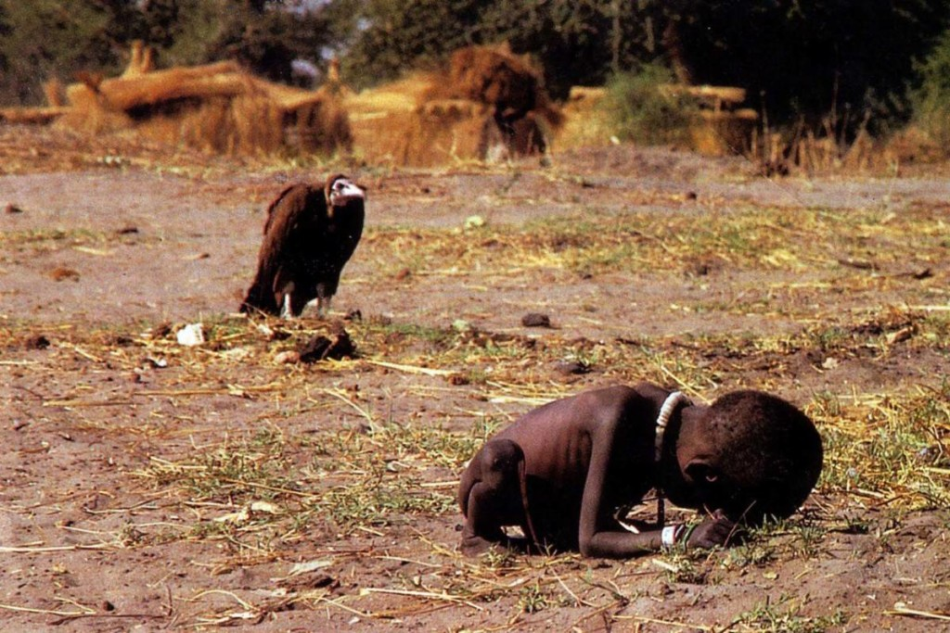

Slide 34
To what extent is a photojournalist expected to help their subjects???
The image shows a suffering girl, obviously malnourished and observed by a symbol of death – the vulture. Clearly, this is a powerful image shot by Kevin Carter in 1993 in Sudan depicting the struggle of the United Nations to provide aid against the famine.
If this picture would be posted online in any discussion forum, people would say, “how could he take a picture of this situation without providing any sort of help?”. The same arguments could be heard during the migration crisis in Europe or the conflict zones in the Middle East.

Slide 35
this shows the dilemma of the photojournalism ethics. On the one hand, this kind of people seeks out dangerous situations where they document people that obviously need help, on the other hand, it is impossible for a single photographer to reach out to all these persons.
So what is the actual solution to this conflict? Shouldn’t Photojournalism exist anymore and human suffering not be documented anymore? Instead, we should all sit in our comforting homes and turn a blind eye to critical areas of the world, while we are in a perfectly safe environment?

Slide 36
What it provides is awareness and pressure on politicians to actually provide aid. Not publishing those images and “censoring” every image of human suffering wouldn’t mean that the world is suddenly a better place.
It would just have the effect that we wouldn’t have to look at these images anymore and slowly they would vanish from the public eye. Without these haunting pictures and news, there wouldn’t even the slightest responsibility for those that are capable to provide any help.
In the end, if you don’t have to watch – it doesn’t exist, right?

Slide 37
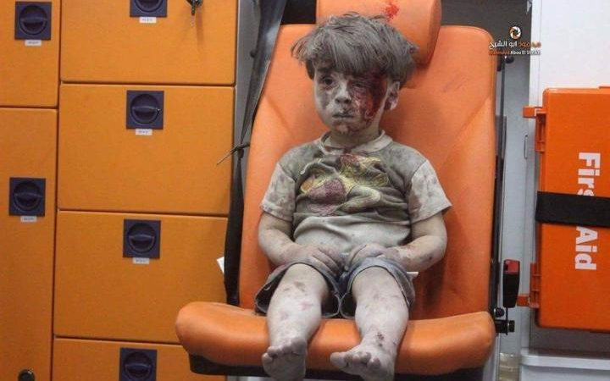

Slide 38
What is often forgot during these discussions is the power, these images can provide and how they can translate emotions into actions. In the more recent news, the picture showing a boy that barely survived the hell that Aleppo is to this very day, made the public aware of the living conditions of more than 100 thousand citizens that still lived in this area.

