Slide 1
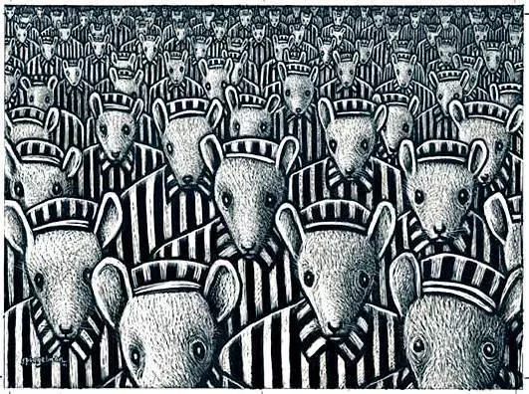
Novel Study/ Lit Circle Unit

Slide 2
Lit Circles – OVERVIEW
You will read ‘Maus’ (and ‘Maus II’ if you finish early).
Once or twice per week you will be an active participant in a Lit Circle discussing the assigned chapters.
When not in your lit circle, you will be reading your novel and completing double entry journals, answering chapter questions, doing your interview assignment, and watching the video.
In this unit you will be evaluated on:
Your double entry journals
Your active participation in lit circles
Your completion of the chapter question booklet.
Your final essay.

Slide 3
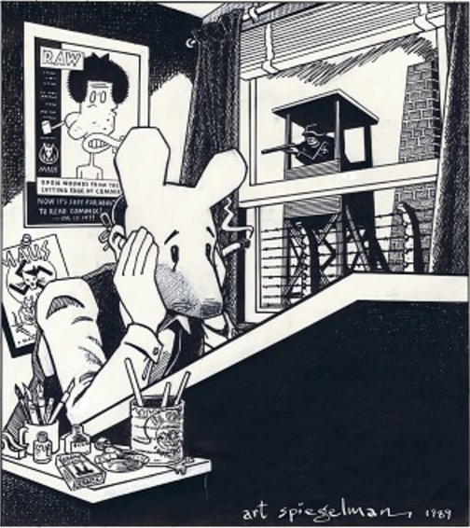
Double Entry
Journals

Slide 4
Double Entry Journals Plan and Practice
Take a piece of lined paper and fold it down the middle
Label the left side “Quotations and the right side “Responses.”
Quotations
Responses

Slide 5
Double Entry Journal Plan and Practice
We will use this strategy during our lit circles, but first we need to practice what it looks like…

Slide 6
Double Entry Journal STATEMENT / RESPONSE STARTERS
I noticed…
It upset me when…
I wonder about…
I don’t really understand…
I now understand…
If I were_____ I would…
I predict that…
I was shocked when/by…
I question…
I think…
I wish…
My reaction to this is…
This is significant to me because…
This images created in my mind from this are…
This part reminds me of…
It seems to me…
I liked the idea that…
I completely disagree with…
I felt…
In my opinion…
I know someone like…
When this happens to me, I feel…
One time I…
It was/was not fair when…
The author could have…
This was a strong quotation to me because…
What impressed me about this was…

Slide 7
‘Still I Rise’ Maya Angelou
(1) You may write me down in history
With your bitter, twisted lies,
You may trod me in the very dirt
But still, like dust, I’ll rise.
(5) Does my sassiness upset you?
Why are you beset with gloom?
‘Cause I walk like I’ve got oil wells
Pumping in my living room.
(9) Just like moons and like suns,
With the certainty of tides,
Just like hopes springing high,
Still I’ll rise.
(13) Did you want to see me broken?
Bowed head and lowered eyes?
Shoulders falling down like teardrops,
Weakened by my soulful cries?
(17) Does my haughtiness offend you?
Don’t you take it awful hard
‘Cause I laugh like I’ve got gold mines
Diggin’ in my own backyard.
(21) You may shoot me with your words,
You may cut me with your eyes,
You may kill me with your hatefulness,
But still, like air, I’ll rise.
(25) Does my sexiness upset you?
Does it come as a surprise
That I dance like I’ve got diamonds
At the meeting of my thighs?
(29) Out of the huts of history’s shame
I rise
Up from a past that’s rooted in pain
I rise
I’m a black ocean, leaping and wide,
Welling and swelling I bear in the tide.
(35) Leaving behind nights of terror and fear
I rise
Into a daybreak that’s wondrously clear
I rise
Bringing the gifts that my ancestors gave,
I am the dream and the hope of the slave.
I rise

Slide 8
What should my journal entry look like?
1) A properly sourced quote or paraphrase on the left.
2) A 3+ sentence response on the right. It should be:
3+ sentences
Show deeper thinking. Not a summary. (ex. What connections can you make to this quote?)

Slide 9
Lets Share!
Did you notice that everyone picked different sections of the poem?
Did you notice how our thoughts can be very different from others’?
Did you notice how our own thinking & understanding are enriched by others’
Meaning and importance lies in the mind of the reader

Slide 10
I am being evaluated on my double entry journals….YIKES!!
You’ve had some practice creating a double entry journal…
Let’s look at the criteria that you will be marked on at the end of the unit…

Slide 11
Lit Circle Discussions

Slide 12
Lit Circle Discussions: How do they Work?
Divide into groups of 5
Chose one student to go first. They will read one of their journal entries.
The person to their left will respond or add to the comment. You are allowed to disagree but please respect the opinion that has been shared.
Then the next person to the left will do the same.
This will continue until the whole circle has participated.
If you have not filled the five minutes when you finish, either repeat the circle or continue the conversation in a more relaxed way.
Remember: Listening is as important as sharing

Slide 13
Criteria For Effective Group Discussion
All voices must be included
All students must feel included
All students must have their ideas respected
The discussion should move us to new understandings
Stay on topic
Listening is as important as sharing

