Slide 1
“The Cradle of Human Race” began in the fertile river valleys of Mesopotamia, Egypt, India & China.

Slide 2
The Fertile Crescent & Mesopotamia 3500 B.C.

Slide 3
Mesopotamia: The Cradle of Civilization
Earliest of all civilizations
“land between two rivers”
Between Tigris and Euphrates rivers (Present day Iraq)
People first abandoned nomadic lifestyles here to build permanent settlements
Considered the pillars of Western Civilization
People began to: create laws, have a monarchy, build places to worship gods, develop writing, invent the wheel

Slide 4
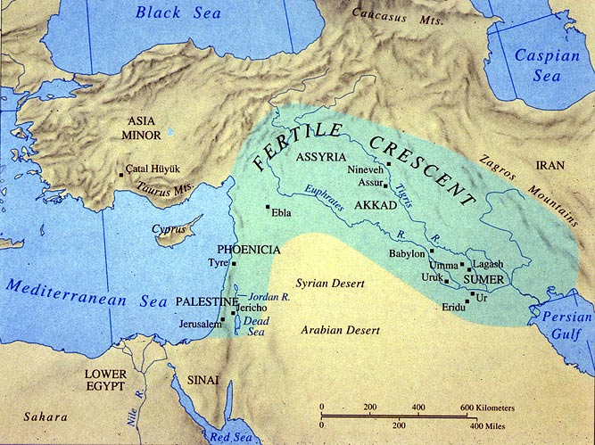
The Fertile Crescent
An arc of land from the Mediterranean to the Persian Gulf
Region provided excellent soil because of layers of silt deposited by the flooding rivers- Great for Farming!

Slide 5
Mesopotamia-Geography
Problems
Solutions
River flooding-unpredictable
No natural barriers
Limited natural resources
Irrigation systems
Built mud brick city walls for defense
Trade for things they needed

Slide 6
Mesopotamia
Farming occurred when people learned to control the flow of the two rivers through irrigation ditches
Crops grew on a regular bases----→abundance of food---→large people lived together to form cities
EMERGENCE OF CIVILIZATION BEGAN HERE!!

Slide 7
Ancient Empires in Mesopotamia

Slide 8
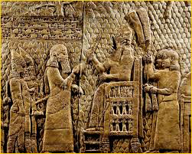
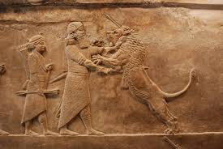
Mesopotamia
Has 3 areas
Assyria
Akkad
Sumer

Slide 9
Sumer & the Ancient Sumerians

Slide 10
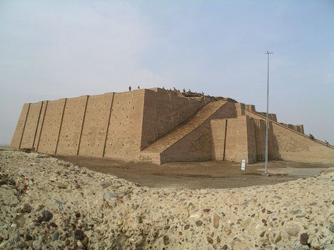
Sumerians
Three powerful cities known as “city-states” (the basic units of Sumerian civilization).
Eridu, Ur and Uruk
Used sun-dried bricks to build these city-states in southern Mesopotamia

Slide 11
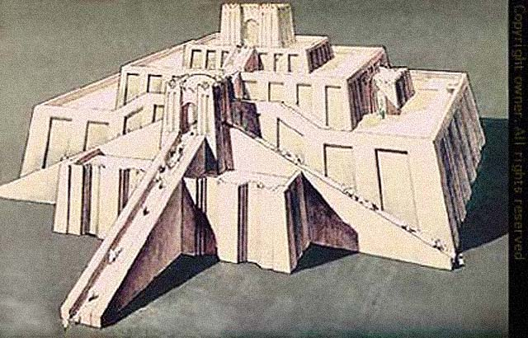
Religion & Government
Polytheistic- worshipped many gods
Most important building in the city was the “ziggurat” which was dedicated to the chief god/goddess. Built atop a massive stepped tower.
Theocracy- government ruled by divine authority
Monarchs (kings) ruled under “divine right.”

Slide 12
Society & Economy
Farming, metalwork, textiles & pottery
Trade with other areas (India)
Imported copper, tin & timber
Exported dried fish, wood, barley & wheat
Social structure
Nobles-royals & priests
Commoners-farmers, artisans, merchants
Slaves

Slide 13
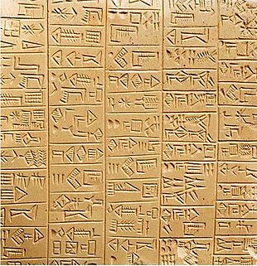
Writing & Literature
Cuneiform- oldest known writing system
“wedge” shaped carved into clay tablets
EPIC OF GILGAMESH- cuneiform epic poem, considered the first novel in human history
Technology
Wheel & wagon
Numbering system based on 60
Potter’s wheel
Simple geometry
Sundial
astronomy

Slide 14
The Epic of Gilgamesh
Written in Sumer perhaps as early as 3000 B.C., the poem tells the story of a god-hero, Gilgamesh, and his quest to escape death and achieve immortality. One sections of this epic tells of Utnapishtim. The gods tell Utnapishtim to build a boat and take with him his family and “the seed of all living things.” They will escape a flood that will wipe out all life on earth.
Have you heard another version of this story? What does the appearance of this story in other cultures tell us about communication between early Middle Eastern and Mediterranean cultures?

Slide 15
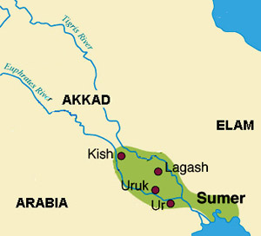
Conflicts
The number of Sumerian city-states grew
City-state fought city-state for control of land/water
Sumerian city-states were open to invasion

Slide 16
Akkadians
North of the Sumerian city-states
SARGON- Leader of Akkadians, overran the Sumerian city-states and set up the first EMPIRE in history
His empire eventually fell
Empire: large political unit or state, under one ruler, that controls many people/territories

Slide 17
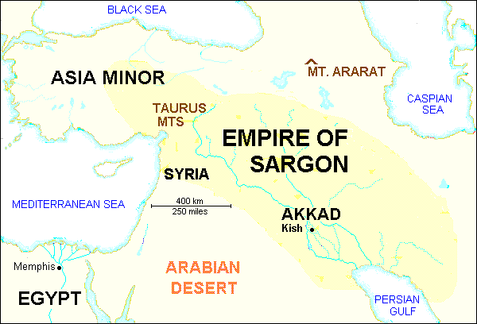
Empire of Sargon

Slide 18
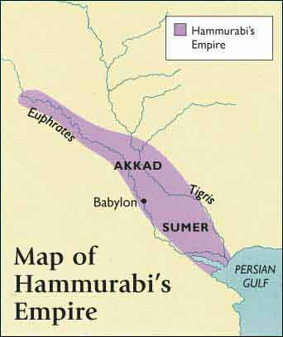
Babylon
City-state south of Akkad
Hammurabi ruled and gained control of Sumer and Akkad – NEW EMPIRE

Slide 19
Hammurabi
King of Babylon 1792-1750 B.C.
United all of Mesopotamia into one empire
VERY POWERFUL
Hammurabi’s Code
282 laws
First major collection of laws in history (written & public)

Slide 20
Hammurabi’s Code
Unequal punishment for rich and poor
Crime against upper class by lower class punished more severely
Duties of public officials were taken VERY seriously
Officials expected to catch burglars
Judges could be fined or lose jobs if ruled incorrectly
Laws for the family
Men could divorce a woman if she did not fulfill her duties
Women could be drowned for neglecting the house
“An eye for an eye”

Slide 21
Hammurabi’s Code
“If a son has struck his father, he shall cut off his hand”
If a woman could not bear children, a husband could divorce her
If a house collapsed and caused the death of the owner, the builder was put to death.
If a house collapsed and caused the death of the son of the owner, the son of the builder was put to death.
If police could not find the murderer, they had to pay a fine to the relatives of the murdered
Arsonists put to death by jumping into a fire

Slide 22
Other Civilizations near Mesopotamia

Slide 23
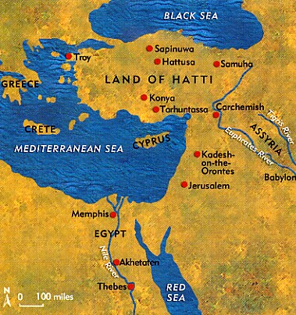
Hittites (2000 BC-1200 BC)
Indo-European people from northern Black Sea began entering Asia Minor
One group of these people moved into the region of Anatolia & formed the Hittite Kingdom & capital city called Hattusha

Slide 24
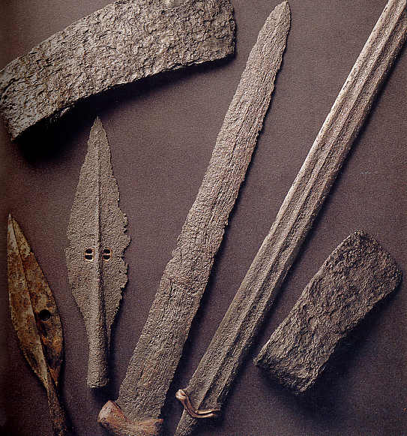
Hittites
Created a large empire across Asia Minor & south along Mediterranean coast
Known for their use of strong IRON WEAPONS. They were much cheaper than copper or bronze.
Outside invaders destroyed the Hittite Empire

Slide 25
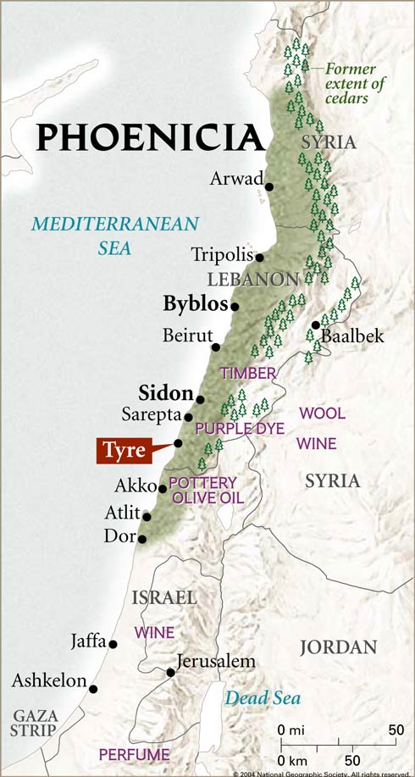
The Phoenicians
After the fall of the Hittite empire, smaller city-states emerged along the 120 miles of the Mediterranean coast
The Phoencians lived in the area of Palestine on this 120 mile narrow band

Slide 26
The Phoenicians
Economy depended on overseas trade & carried goods throughout the Mediterranean & European coasts
Established port colonies throughout the Mediterranean
Most famous colony was CARTHRAGE in North Africa
Map

Slide 27
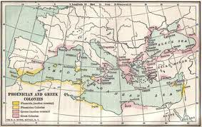

Slide 28
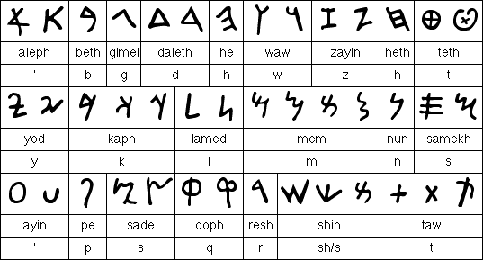
The Phoenicians
Best remembered for creating the first modern alphabet of 22 signs that represented sounds

Slide 29
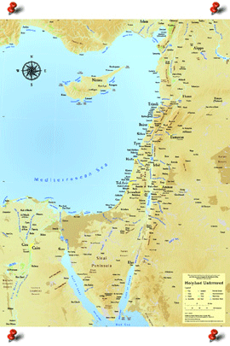
The Israelites
(1200 B.C. – Present)

Slide 30
The Israelites
South of the Phoenicians
FAMOUS for their religion- JUDAISM which later influenced Christianity & Islam
Much of their history is written in the Hebrew Bible (Old Testament)

Slide 31
The Israelites
Migrated from Mesopotamia to Canaan (present-day Palestine) led by ABRAHAM
Lived a life of grazing flocks and herds rather than farming
Drought & famine forced them to Egypt where they became enslaved
Moses led them out of Egypt and back to Canaan

Slide 32
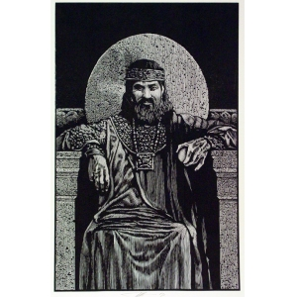
The Israelites
King Solomon ruled Israel from 970 B.C. to 930 B.C
Jerusalem- capital of Palestine
He built the HOLY TEMPLE in Jerusalem
Expanded government, army & trade

Slide 33
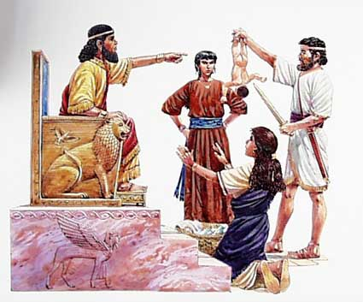
King Solomon

Slide 34
After King Solomon
Israel divided into 2 kingdoms
Israel (north)
Judah (south-Jerusalum capital)
722 B.C. the Assyrians overran Israel, scattering the Jews (North)
586 B.C.- The Chaldeans overran Judah & destroyed Jerusalam (South)
The people of Judah were sent to be prisoners of Babylonia. The Persians eventually freed them back to Jeruselum.

Slide 35
Judaism
First monotheistic religion- belief in ONE god
One god named Yahweh
Believed all could have a personal relationship with this being
Yahweh commanded Jews to live by the TEN COMMANDMENTS
Believed God sent PROPHETS to guide people & serve as HIS voice
Pg. 58

Slide 36
The Assyrians
1900 B.C.-612 B.C.)

Slide 37
The Assyrians
Assyria- upper Mesopotamia region
For more than 1,000 years, Assyrians lived in small city-states
700 B.C. Assyrians established a large empire in the upper Tigris River valley & built their capital Neneveh
Ruled by one king with absolute power but divided lands between a system of governors
Considered to be the most feared warriors in the ancient world for more than 500 years by using terror

Slide 38
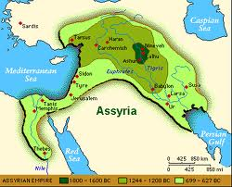
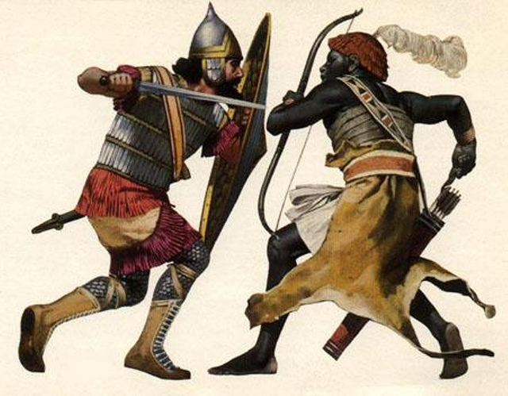

Slide 39
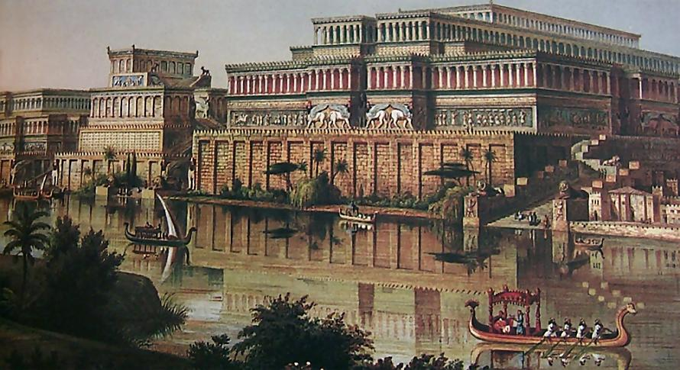
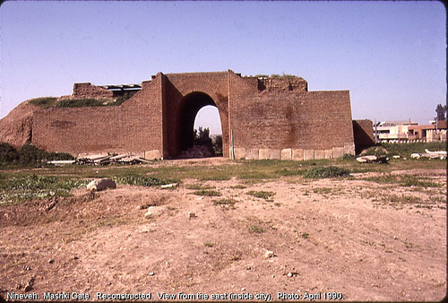

Slide 40
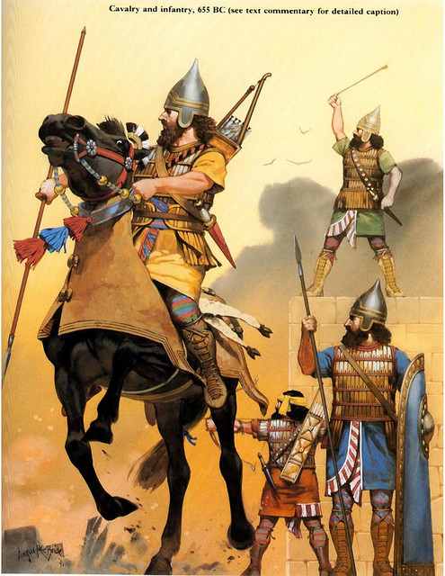
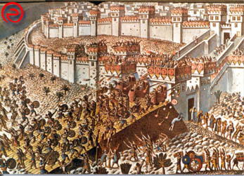
The Assyrians
Armies used large scale iron weapons, cavalry, horse-drawn chariots, & multiple fighting tactics
War was to appease their god ASSUR

Slide 41
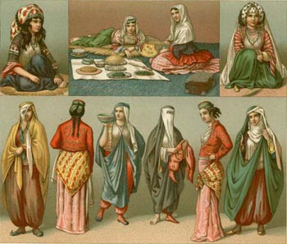
The Assyrians
First society to require women to be veiled in public

Slide 42
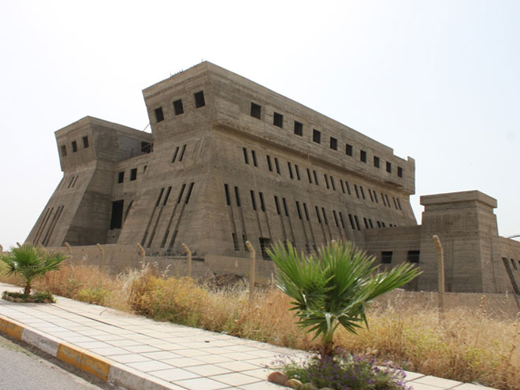
The Assyrians
King Ashurbanipal built the world’s first library to preserve traditions of conquered civilizations

Slide 43
The Persian Empire
539 B.C.-331 B.C

Slide 44
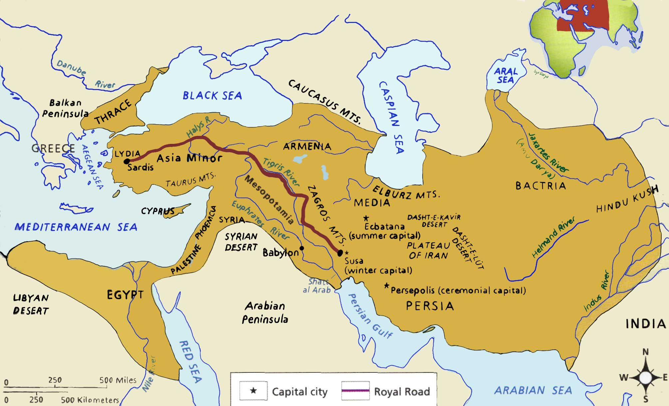
The Persians
Defeats the Assyrian empire
The Persian King Cyrus, creates a powerful Persian empire that stretched from Asia Minor to western India

Slide 45
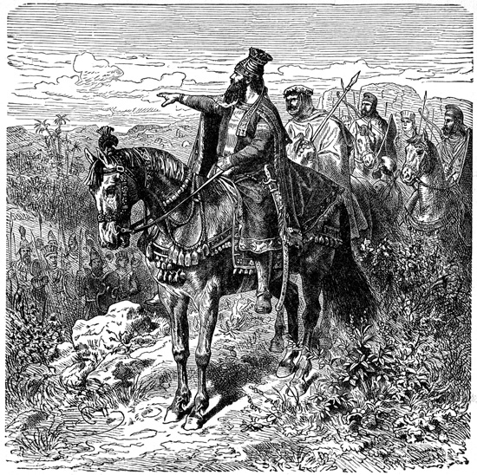
King Cyrus
Demonstrated much wisdom and compassion
Reputation for mercy
After capturing Babylon from the Assyrians, he freed the Jews back to Jerusalem

Slide 46
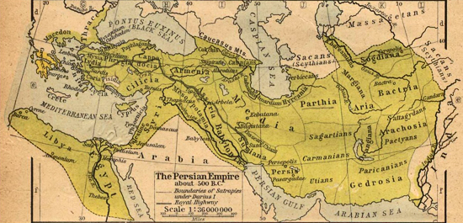
King Darius
Ruled after King Cyrus
Strengthened the government by dividing the empire into 20 provinces called satrapies ruled by a govenor called a satrap
Sent officials called “Eyes and Ears of the King” to check on satraps

Slide 47
The Persian ROYAL ROAD
The empire was connected by miles of roads for efficient communication between satrapies and the King
The Royal Road stretched almost throughout the entire empire
Stations were set up along this road for food, shelter, fresh horses and messengers

Slide 48
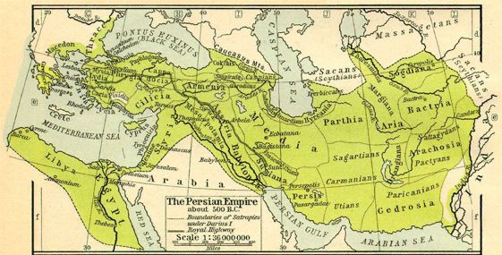

Slide 49
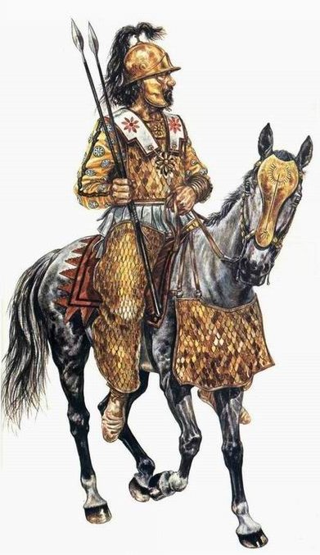
The Persian Army
The Immortals
King Darius set up a large, permanent standing army of professional soldiers from across the entire empire.
Their numbers were never allowed to fall below 10,000

Slide 50
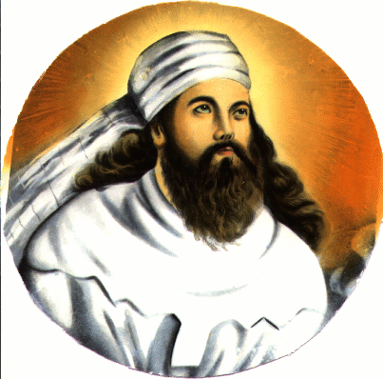
Persian Religion
Zoroastrianism- monotheistic religion worshipping ZOROASTER
Zoroaster wrote down his beliefs in the Zend-Avesta
Believed humans played a part in the struggle between good & evil and that humans had the right to choose between the two
Believed the soul would either enter paradise or be condemned to suffering after death

Slide 51
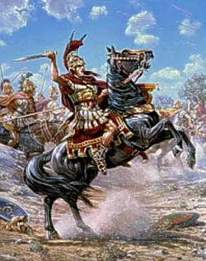
Fall of the Persian Empire
Increased taxes caused disloyalty to the King
Future Persian Kings had many sons who fought for control and weakened the empire (one king had 115 sons!!!)
Alexander the Great conquers the Persian Empire in 331 B.C.

