Slide 1
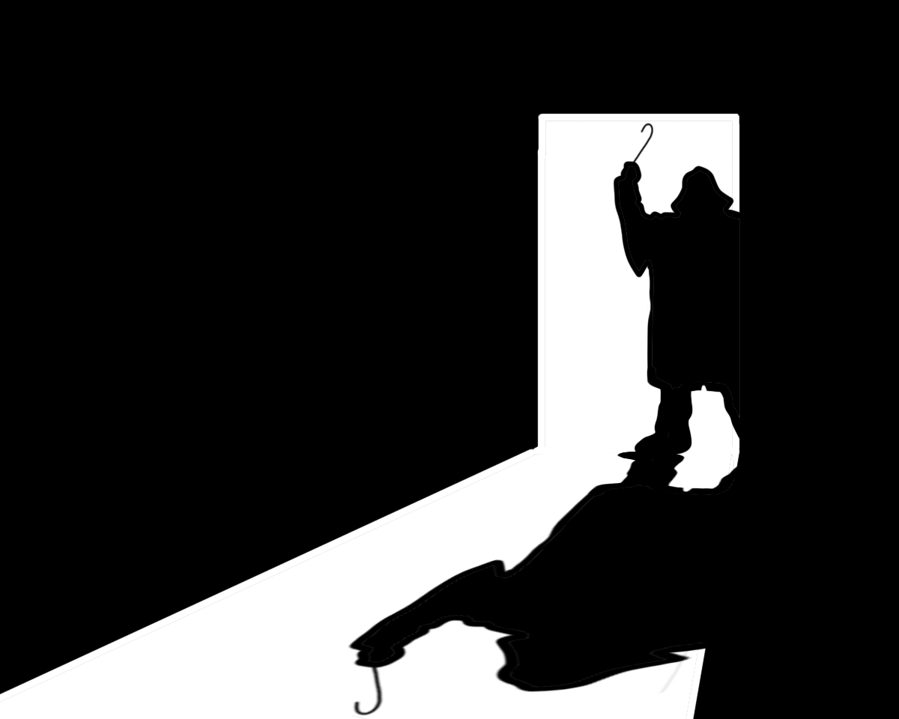
Modern Mythology: URBAN LEGENDS

Slide 2
What are Urban Legends?
One of the few remaining methods of storytelling that still remains very oral.
Urban legends spread through word of mouth, Facebook and junk mail in our inboxes.
These are not myths in the strictest sense; however, they do help us see the nature of oral storytelling.

Slide 3
Urban legends show us the power of storytelling. Although not everyone believes these stories, there are a large number of people that do.
Urban legends express concerns and beliefs within a culture than many believe are worth spreading.

Slide 4
Common Traits of Urban Legends:
There are many versions of a similar story.
Nobody can prove the origin of the story.
It happened to a “friend of a friend.”
Morals and tone reflect a fear or moral within a society.
Although the story may contain true concerns or conflicts, it is often mostly based on lies.

Slide 5
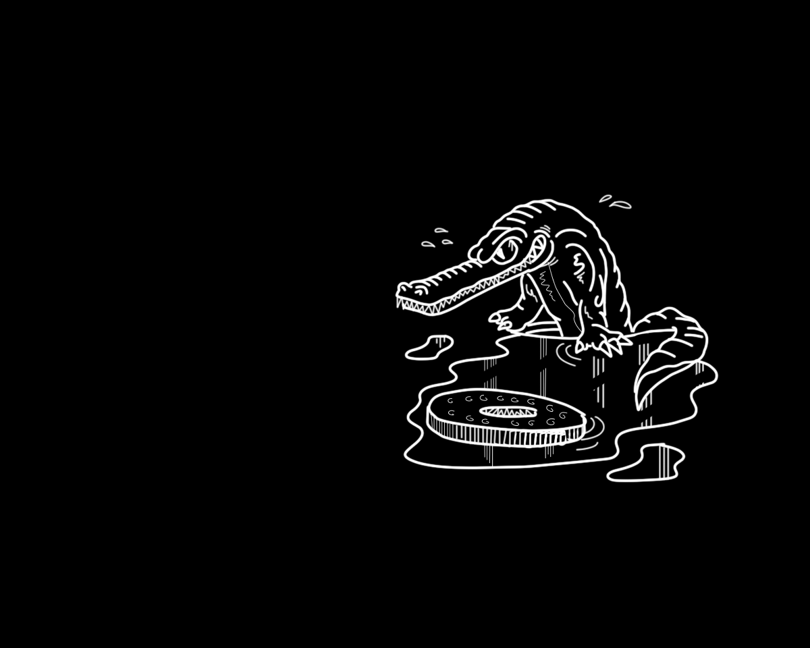
Alligators in the Sewer
In the late 50s baby pet alligators were a fad in the United States.
When the pets got to big or became to much trouble they were flushed down the toilet and have been living in the sewers ever since.
Origin: it was reported that an alligator was found in a Manhattan sewer in 1935.

Slide 6
Discuss: 1) What cultural fear does this story exploit that has made people latch onto and re-tell this story?
2) What do you think the theme/ moral could be?

Slide 7
Some Possible Answers:
Mass Fear:
Representation of the fear of something unclean in civilization.
Fear of the unknown parts of living in a big city.
Theme/Moral:
Be respectful of nature.
Be responsible with your pets
You are never fully protected from nature.
Be careful in the city

Slide 8
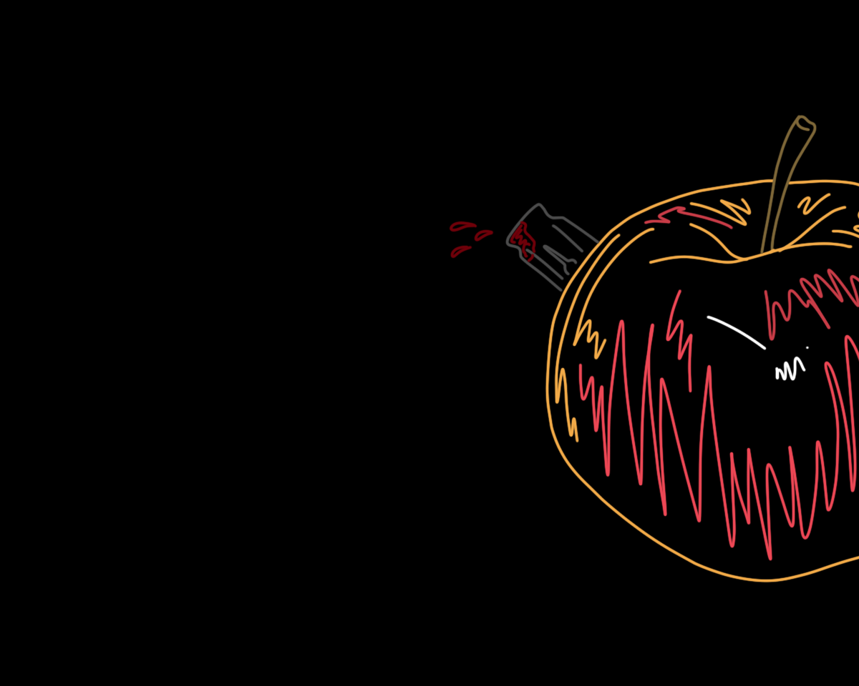
Razor Blades in Halloween Apples & Poisoned Candy
Have you ever been told not to touch you Halloween candy until your parents have checked it?
-This legend can be traced back to the mid 60s
- A recent study tracked 80 cases of sharp objects in food since 1959 and almost all were hoaxes. Only 10 caused even a minor injury and the worst was a few stitches.
…. Why did this urban legend circulate as much as it did?????

Slide 9
Discuss: 1) What cultural fear does this story exploit that has made people latch onto it and re-tell this story?
2) What do you think the theme/moral could be?

Slide 10
Some Possible Answers:
Fear:
The fear and mistrust society has being so close to their neighbours (strangers). Suburbanization became more common after WWII and people were not used to being so close to and accepting of neighbours.
Strangers’ intentions with our children.
Theme/Moral:
Be careful around strangers.
Keep an eye on your children.

Slide 11
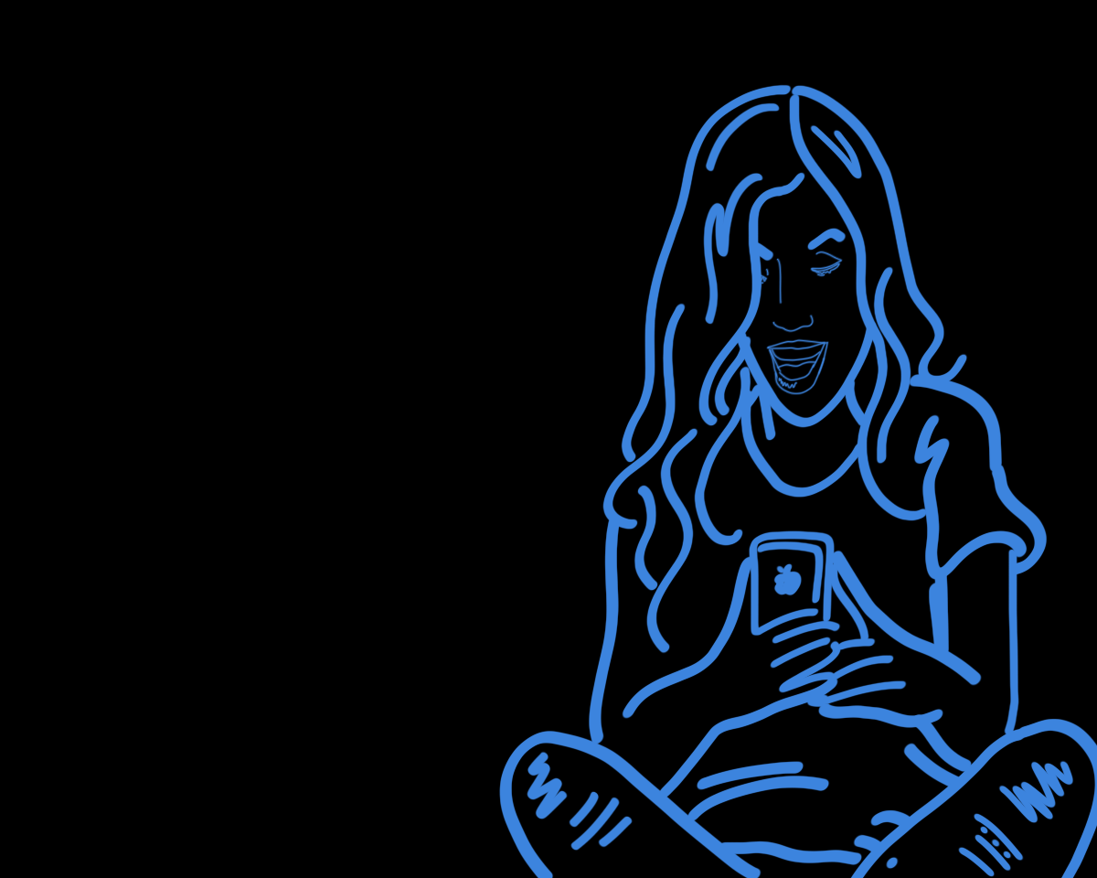
Urban Legends About Teenagers
Urban Legends About Teenagers

Slide 12
The Hook Man
1) A couple is at lovers’ lane 2) The radio says there is an escaped mental patient.
3) The girl wants to stop making out. The boy does not.
4) She convinces him and they go home.
5) When they arrive home they notice the hook hanging from the door of the car.
In some stories the boy hears a noise and goes out to investigate. He is killed and is hung above the car with his fingernails scraping the roof.
https://www.youtube.com/watch?v=OX7ZPW5_TGg

Slide 13
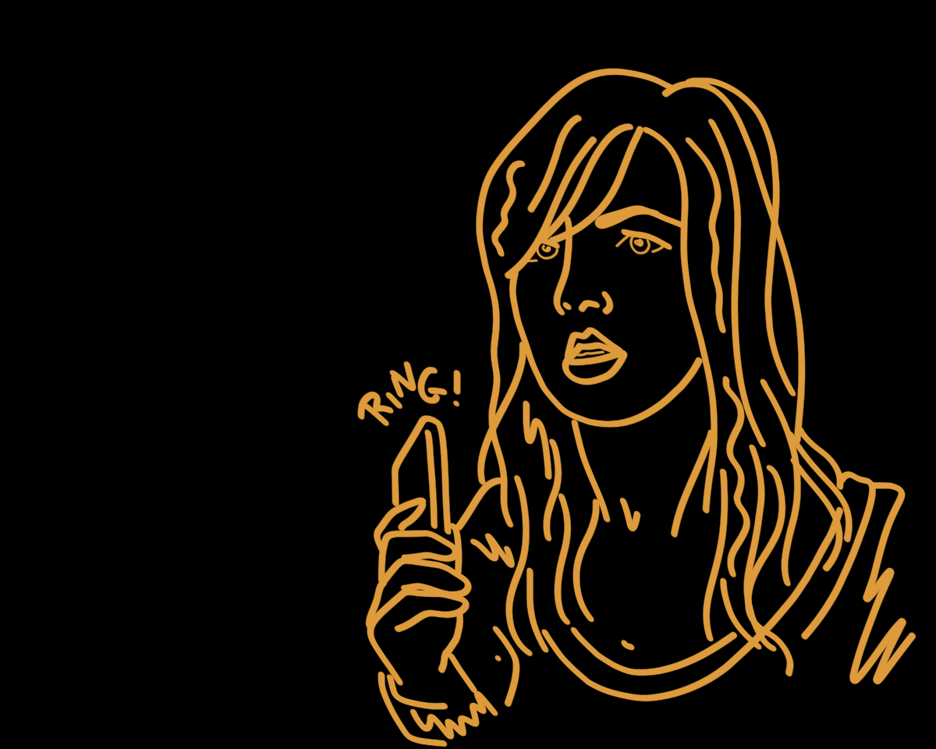
“The calls are coming from inside the house…”
1) A babysitter has put the kids to bed.
2) She starts getting threatening phone calls.
3) She calls the police
4) They call her back after
tracing the call.
5) The calls are coming
from inside the house.
6) She runs upstairs. The
children have been murdered.

Slide 14
Top 8 Urban Legends About Teenagers….
1) The babysitter (calls are coming from inside…)
2) Stranger follows you at gas station. It turns out a killer in the back seat of the car.
3) Humans can lick too (killer under the bed)
4) Aren’t you glad you didn’t turn on the lights (college roommate murdered).
5) Bloody Mary
6) The hook man at lovers’ lane
7) The kidney thief
8) Clown statue (babysitter)

Slide 15
Discuss:
What other urban legends have you heard???
What is the lesson that they are trying to teach???

Slide 16
Make Your Own Urban Legend!
Write a 1 page short story.
Consider:
Who is your target audience (i.e. Teens, parents, adults, retail workers, teachers)
What is the mass fear they have that you are exploiting?
What is the theme/ moral that you are promoting?
How are you going to make the story seem realistic?
*** remember: it always happens to someone very close to someone that you know. That way, it seems legitimate that you would hear the story but there’s no way that you can prove it.

Slide 17
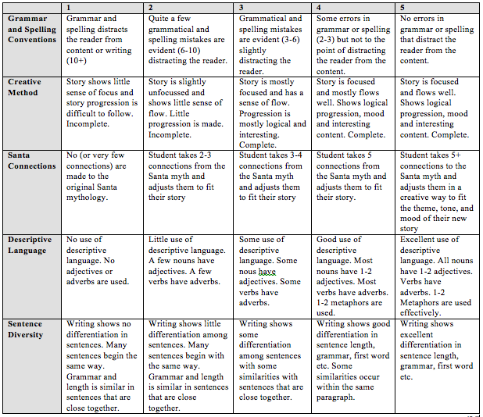
/25

Slide 18
Sources
Title:
http://img.fotocommunity.com/Architecture/Cityscape/Urban-Legend-13-a19748927.jpg
Alligators:
http://www.backofthecerealbox.com/2006/07/alligator-in-sewer.html
Apple:
http://www.ohnuts.com/blog/2009/10/biggest_halloween_candy_myths_1.html
Top 10:
http://urbanlegends.about.com/od/horrors/tp/top10scariest.htm
When a Stranger Calls:
http://moviebugz.blogspot.ca/2012/03/movie-review-when-stranger-calls-2006.html
Questions:
http://www.fanpop.com/spots/urban-legends/images/231566/title/always-check-back-seat-photo

