Slide 1
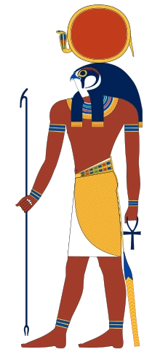
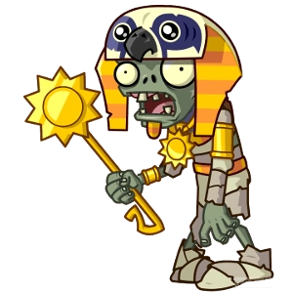
Ra

Slide 2
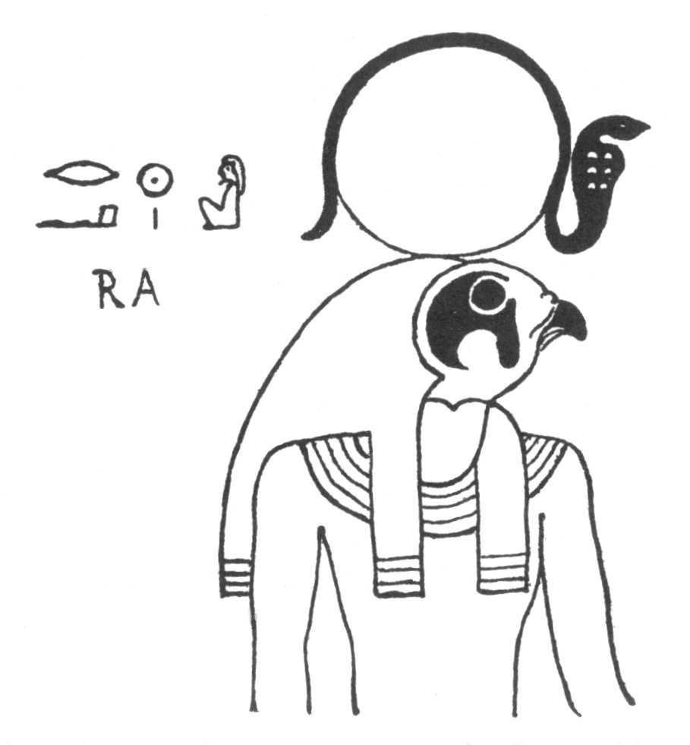
Who He Is
Ancient deity of the sun - the sun God
Ra is first mentioned in ancient Egypt's Second Dynasty
He became one the most popular Gods in Egypt’s Fifth Dynasty.
Identified with the Midday sun

Slide 3
What he is worshipped for
Ra was the God of the sun
It is said he was the ruler of all Egyptian Gods
Was believed to create Earth and all forms of life that inhabit Earth, as well as creating Heaven and Hell
Most important God in Egypt by the 5th Dynasty

Slide 4
What he looked like (form)
Ra was usually depicted in human form.
He had a falcon head which is crowned with a sun disc.
This sun disc was encircled by a sacred cobra named Uraeus.
Ra has also been depicted as a man with the head of a beetle and also a human man with the head of a ram.

Slide 5
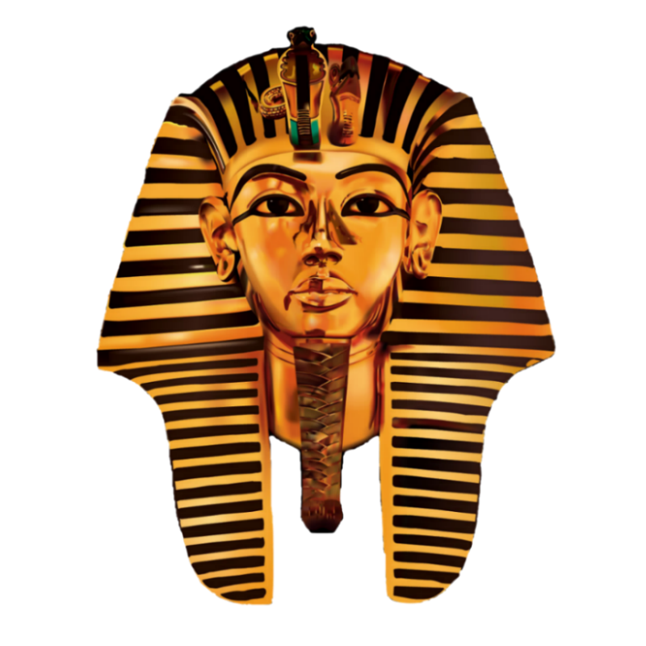
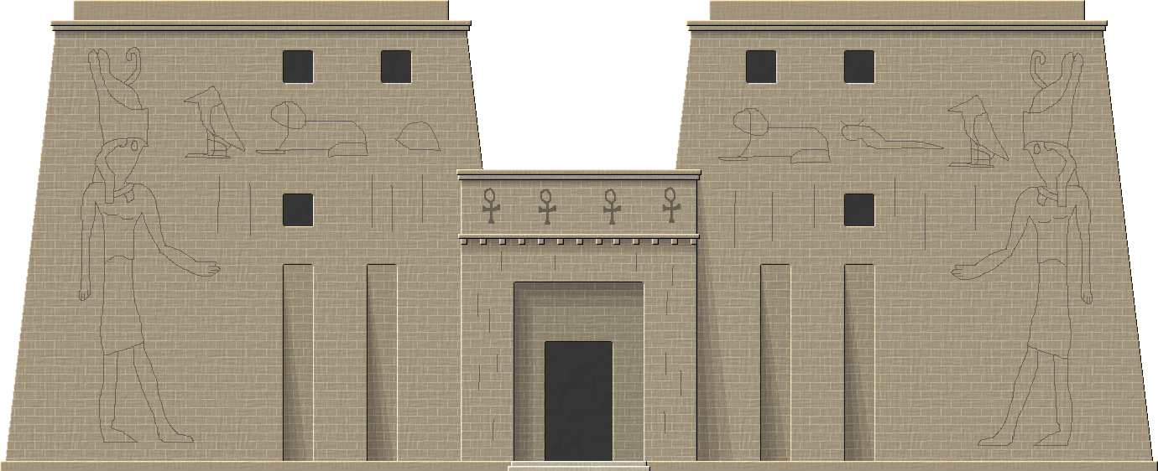
Importance of Ra to Egypt
Became extremely important during the 5th dynasty
Each pharaoh was believed to be a humanly manifestation of Ra himself
During this period, pharaohs spent the majority of Egypts money on temples to worship Ra
There were often no statues of the God himself, due to the fact that he was represented by the rays of sun beaming into the temples
Many prayers and blessings for him to overcome Apep, his sworn enemy

Slide 6
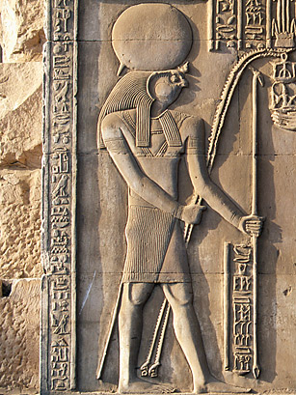
Other interesting facts
Many great temples were built in honor of Ra. Many of these structures were built with no roof in order to let the sunlight in.
Fifth Dynasty and subsequent pharaohs were all known as “The son of Ra” and Ra became incorporated into every pharaoh’s name from then onward
Many tombs in the Valley of the Kings portray depictions of Ra and his journey through the underworld.
Nut, goddess of the sky and heavens, is sometimes referred to as Ra’s mother, because he emerges from her and is reborn every morning.

Slide 7
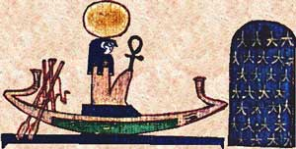
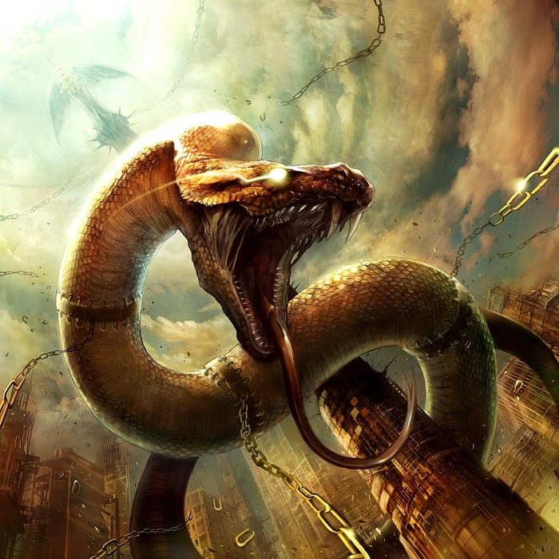
Relations to other Gods
Apep
Battled with Apep every night as Ra travelled through the underworld (carried the prayers and the blessings of the living to the dead in his boat called the solar barque)
One night, Apep used his gaze to overwhelm Ra and his entourage, however Set and the eye of Ra ( represented in the form of one of his daughters) to aid Ra and defeat Apep
Worshipped in temples by priests for Ra’s victory
Amun-Ra
By the 18th dynasty, Ra had merged with the God Amun, a patron of Thebes
Considered to be the supreme God, as Ra once was
Also was the “father” of the pharaohs, like Ra

Slide 8
Thanks for listening!

Slide 9
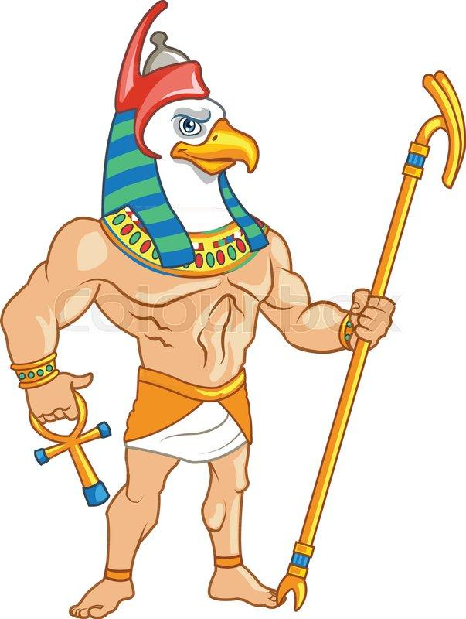
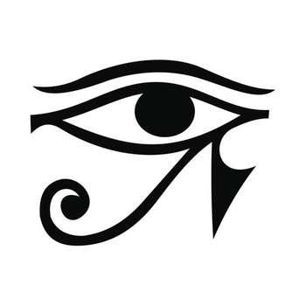
Horus

Slide 10
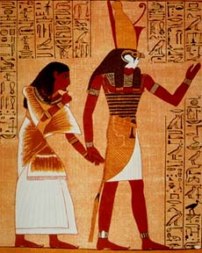
Who is he?
Horus was thought to be the god of sky
He was also associated hunting and war
The majority of his followers were from lower Egypt
One of the most important avian deities in Ancient Egyptian history
Worshipped between Early Dynastic period - Ptolemaic Kingdom

Slide 11
Why was he worshipped?
Each of Horus’ eyes represented both the moon, and the sun
He had reunited upper and lower Egypt after defeating Set
He was a symbol of the reunited country
Pharaohs were thought to be the incarnated bodies of Horus

Slide 12
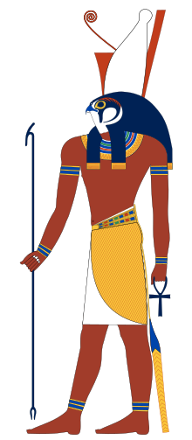
What he looked like (form)
Took the form of a falcon with the body of a man
Horus looked very similar to Ra
Instead of having a sun disc above his head, he had a red and white crown
Also called a pschent

Slide 13
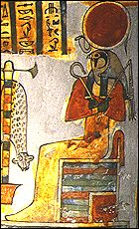
Other Interesting Facts
Horus and Ra could combine to create Ra-Horakhty
Since Ra was the god of sun and Horus was the god of the sky, they could both combine to become the god of the rising sun
They represented the sun as it was moving throughout the day
Horus also had 2 more forms (Horus the elder) and (Horus the younger)

Slide 14
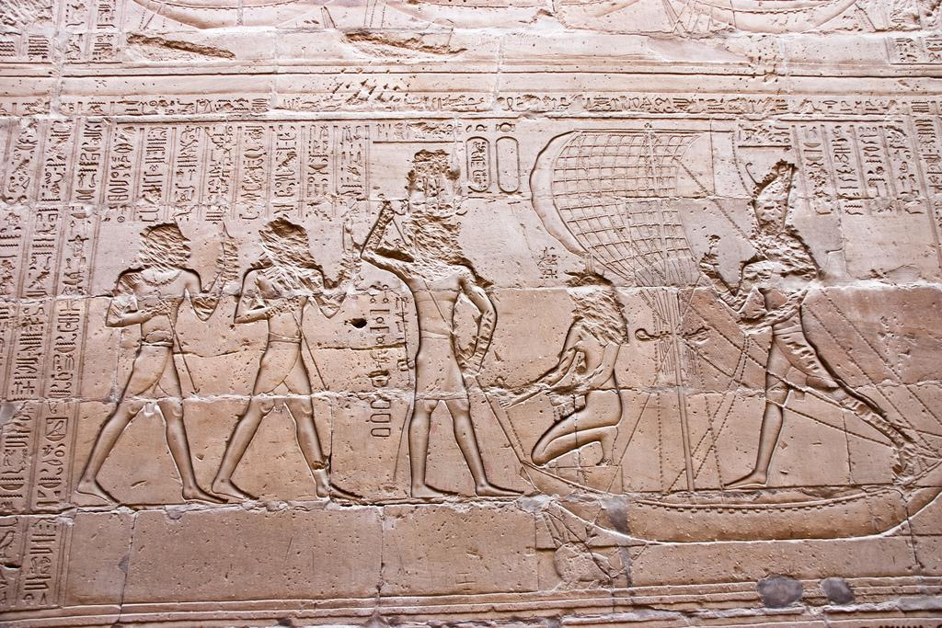
Conflict between Horus and Set
Set (the god of storms and the desert) was heavily worshipped in upper Egypt, while Horus was worshipped in lower Egypt
They had to undertake a series of test to see who would become the ruler of Egypt
In one challenge, Horus and Set had to turn themselves into Hippopotamuses and see who could hold their breath the longest
In another, the 2 gods had a boat race where their boats needed to be made of stone, Horus had made his out of wood and painted it to look like stone which allowed him to defeat Set, and become the ruler of Egypt

