Slide 1
Canada’s 100 Days
Hannah² and Gavin Termuende

Slide 2
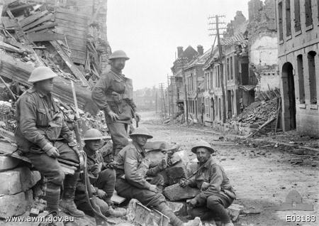
A Brief Summary:
Canada’s 100 days was a series of attacks lead by the Canadian Corps against the German army that took place in Northern France during the last 100 days of World War 1.

Slide 3
Outcome:
The Canadian Corps forced the German army to retreat away from Amiens to Mons which led to the Germans surrendering and eventually the signing of the Armistice of Compiegne and the Treaty of Versaille.
An Armistice is an agreement to stop fighting. In this case it was signed by Britain, France and Germany on November 11th 1918.
Six months later the Treaty of Versaille was signed.

Slide 4
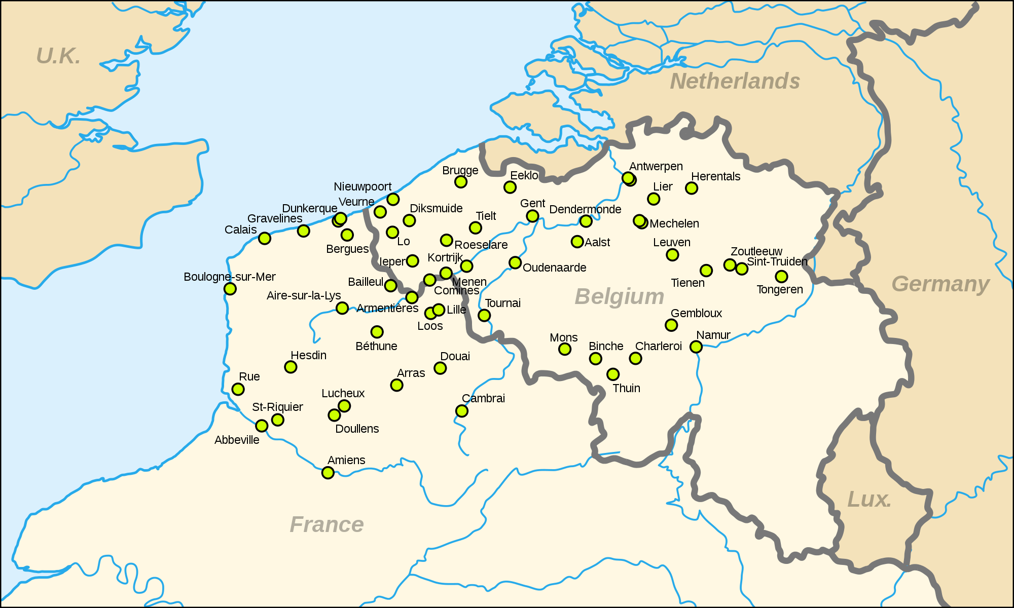
Location:
Canada’s 100 days took place throughout northern France (Amiens) and southern Belgium (Mons).

Slide 6
Significant Events:
The crossing of the Canal du Nord was a highlight of this battle. It meant they had broken through the Hindenburg line and and led to capturing the Burlon woods, which would allow the first army to create a defensive line northeast of Cambria to cover the first army as it advanced.

Slide 7
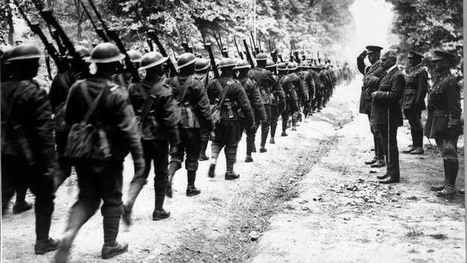
Cost:
At the end of the 96 days of battle,
Canadians lost upwards of 6,800 troops
and left almost 40,000 wounded
Canadian soldiers marching past General Sir Arthur Currie, Commander of the Canadian Forces in Europe and Prime Minister Borden

Slide 8
Reasons for Success:
During the first battle in Amiens the Canadian Corps used the element of surprise.
The crossing of the Canal de Norde was great defensive move.
The whole Canadian Corps marched in the canal towards the German army. This allowed them to all attack at once and capture the Burlon Woods and breach three German lines.

Slide 9
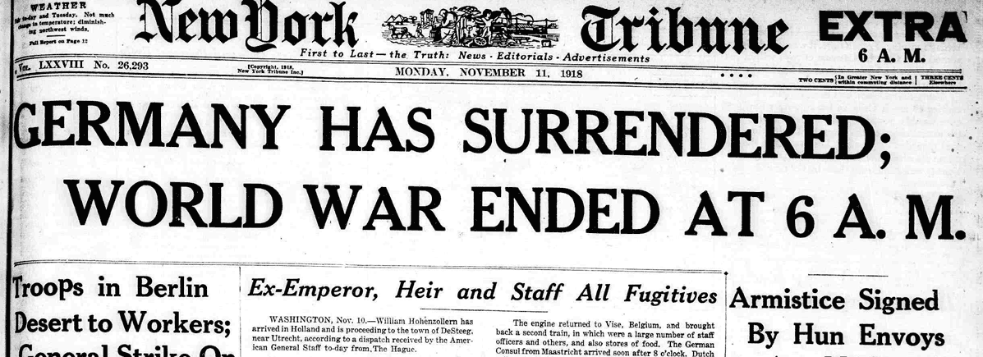
Overall Significance:
The series of battles that took place during Canada’s 100 days led to the retreat of the German army out of France. This then led to their surrender and the end of the First world war.

Slide 10
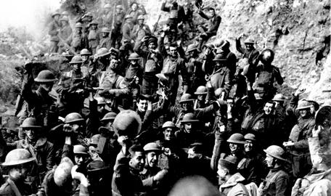
Canadian Importance:
At the end of WW1 Canadians are known as the “Best Attacking Allied Troops”
Hundred Days was important to the success of WW1 and could not have been completed without the effort from Canada

Slide 11
Brief Recap:
When? - August 8th to November 11th 1918
Where? - Northern France to Southern Belgium
Who?
Offensive: Canadian Corps
Defensive: German Army

Slide 12
Kahoot!
https://play.kahoot.it/#/k/8c95ae83-a501-495a-b66a-7b7186d1d66d

Slide 13
Sources:
http://www.warmuseum.ca/firstworldwar/history/life-at-the-front/military-structure/the-canadian-expeditionary-force/
http://www.veterans.gc.ca/eng/remembrance/history/first-world-war/canada/canada15
http://www.veterans.gc.ca/eng/remembrance/history/first-world-war/fact_sheets/hundred-days
https://en.wikipedia.org/wiki/Canada's_Hundred_Days
http://www.thecanadianencyclopedia.ca/en/collection/canadas-hundred-days/
http://www.canadaatwar.ca/forums/showthread.php?t=2695

