Slide 1
Second battle of Ypres
Nina Sean Tara

Slide 2
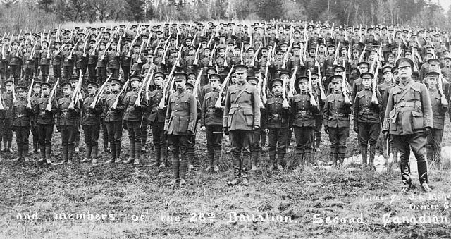
Canadian Expeditionary Force
First major battle fought by Canadian troops in the First World War
More than 31,000 men volunteered
Training period in England from october 1914 and arrived in France in February the next year.

Slide 3
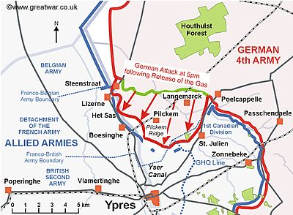
Outline of 2nd Battle of Ypres
Who: German Fourth Army fought against French, British Second Army (Canada).
What: German army used poison gas effectively in battle for the first time in history.
Where: Ypres Salient, Flanders.
When: April 22nd to May 25th, 1915
Why: The German army had a goal to eliminate the Ypres Salient, in order to allow them to threaten the channel ports.

Slide 4
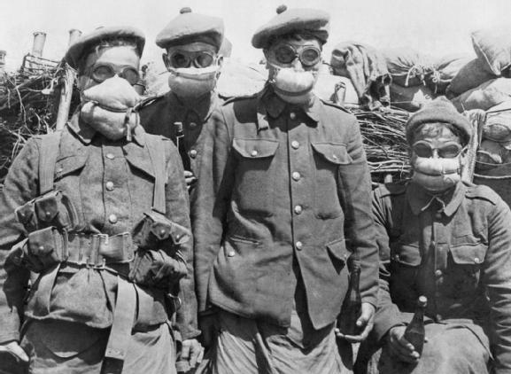
Significant events
First major battle fought by Canadian troops.
First time a former colony (Canada) defeated a European Empires (German)
In Flanders Fields was written 20 min during this battle, John McCrae.

Slide 5
Significance of the battle in term of the overall war
First time Germans had successfully used chemical weapons on a large scale on the Western Front. They would continue to do so for the rest of the war.
Following these battles, the British and French started developing their own chemical weapons and gas masks.

Slide 6
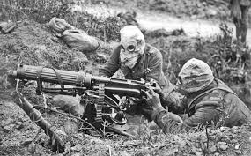
Cost of Ypres#2
It has been estimated that the Germans used 68,000 tons of gas against Allied soldiers. This was more than the French Army (36,000) and the British Army (25,000)
6,000 Canada’s casualties, 2000 dead
59,000 British casualties
Outcome: The French and Canadian troops were forced to retreat and over 6,000 Canadians lost their lives.

Slide 7
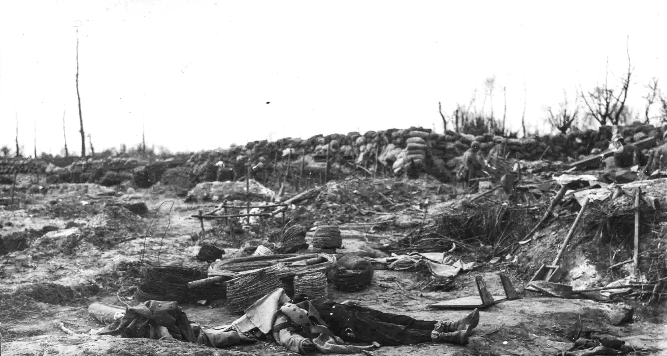
Battle of Gravenstafel Ridge (22–23 April 1915)
In the hamlet of Gravenstafel at about 5:00 p.m. on 22 April, the German Army released 168 long tons (171 t) of chlorine gas over a 6.5 km (4.0 mi) front on the line .
The French troops in the path of the gas cloud sustained about 6,000 casualties. Many died within ten minutes , and many more were blinded.
German troops carried 5,730 gas cylinders, weighing 90 pounds (41 kg) each, to the front by hand. The cylinders, opened by hand, relied on the prevailing wind to carry the gas towards enemy lines. Because of this method of dispersal, a large number of German soldiers were injured or killed while carrying out the attack.

Slide 8
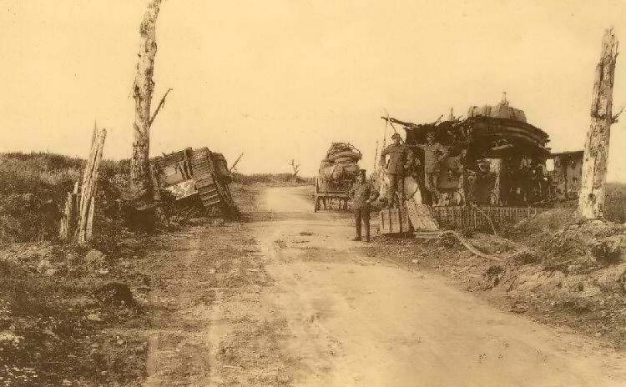
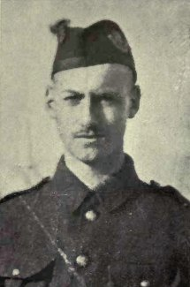
Battle of St. Julien (24 April – 5 May)
soldiers preferred to use a handkerchief, sock or flannel body-belt, dampened with a sodium-bicarbonate solution and tied across the mouth and nose, until the gas passed.Soldiers found it difficult to fight like this. By July 1915, soldiers received efficient gas masks and anti-asphyxiation respirators.
On the morning of 24 April, the Germans released another gas cloud towards the re-formed Canadian line just west of St. Julien. lance corporal Frederick Fisher of the 13th Battalion CEF's machine-gun detachment; Fisher went out twice with a handful of men and a Colt machine gun, preventing advancing German troops from passing through St. Julien into the rear of the Canadian front line. He was killed the following day.

Slide 9
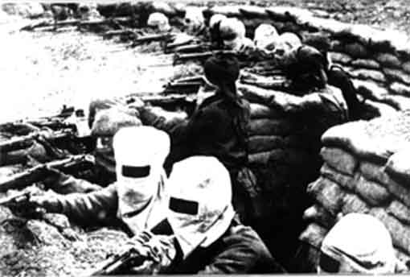
Canada’s contribution in Ypres #2
•Canadians were quick on their feet and used urine-soaked cloths to cover their mouths and noses to neutralize the chlorine while advancing to the German lines, stopping German’s success.

Slide 10
Reason of success or failure of the battle (Canada)
Reason of success:
Canada was a new country, first time joined in big battle → Young and powerful fighting spirit
Talented commanders
Reason of failure:
Lacked of fighting experiences
Unpreparation (poison gas)

Slide 11
references
http://www.thecanadianencyclopedia.ca/en/article/battle-of-ypres/
http://www.alexander.com/
https://en.wikipedia.org/wiki/Second_Battle_of_Ypres
http://cjmorton.org/ww1service/ww1/overview/ypres.html
Thank you

