Slide 1
Canada’s Hundred Days
The final 100 Days of WWI
By Liam Wilson, Lou Hobbs, and Ross Macpherson

Slide 2
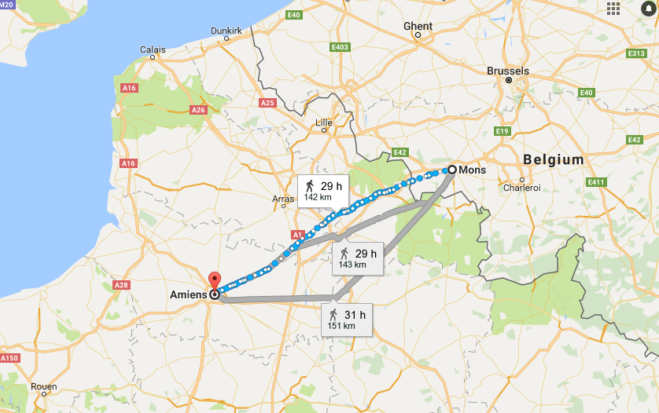
Location
The war started near Amiens, France and continued to Mons, Belgium

Slide 3
Significance
-Canada’s Hundred Days was the final part of WWI
-Canadian Corps played significant role in causing German retreat/surrender
-Canadians were known to be successful in battles such as Vimy Ridge.
-Our soldiers were at front of attacks
-Fought in many battles from Amiens to Mons, pushed Germans out of France
-Ultimately lead to victory for Allies on November 11, 1918
Canadian Corps Formation Sign

Slide 4
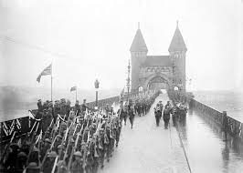
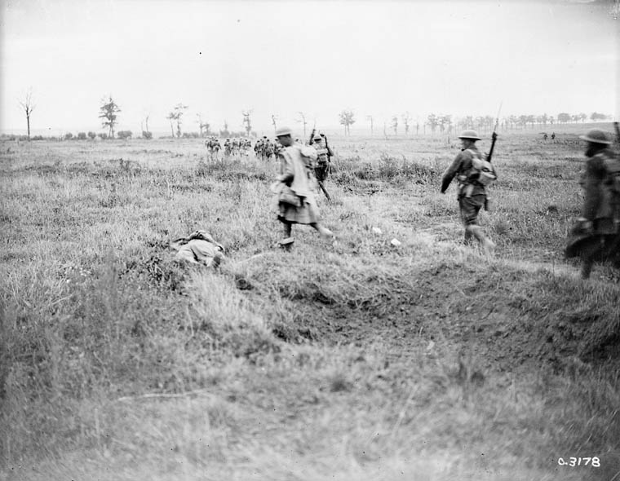
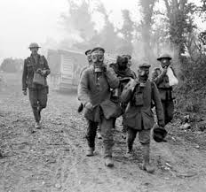
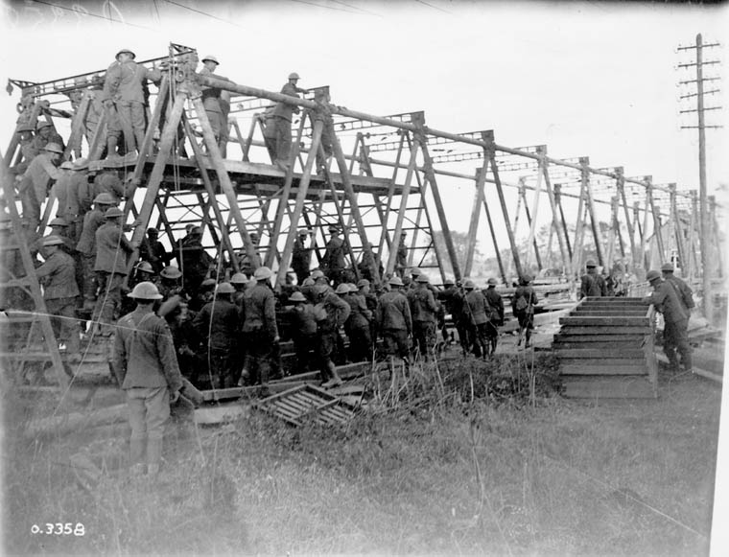
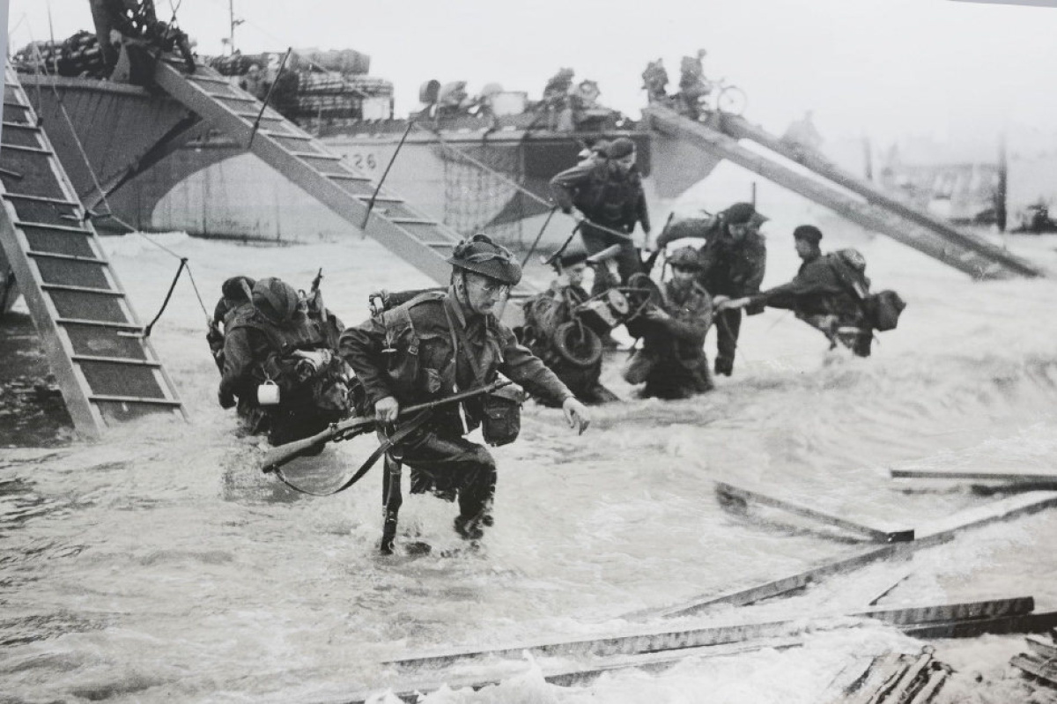
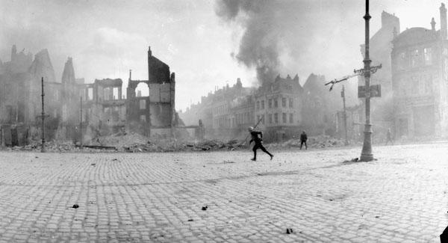

Slide 5
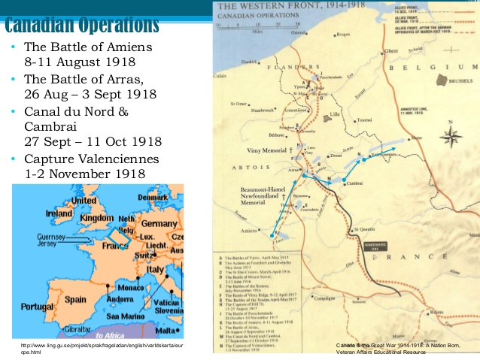
Outline of Battles
Battle of Amiens
Second Battle of the Somme
Battle of the Scarpe
Battle of the Canal du Nord
Battle of Cambrai
Battle of the Selle
Battle of Valenciennes

Slide 6
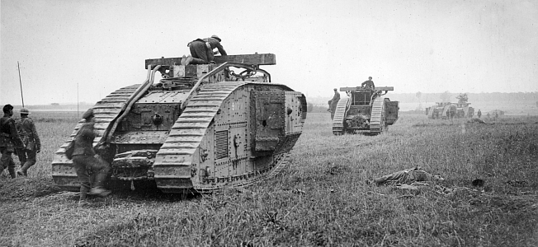
Battle of Amiens
-Battle began morning of August 8th 1918 in thick fog
-Pushed the Germans out over the coming days
-Canadian Corps captured 9,131 prisoners, 190 artillery pieces, 1,000 machine guns and trench mortars during the battle.

Slide 7
Significant Events
Breaking the Hindenburg Line (very powerful German defensive line) -September 2, 1918, Canadian Corps destroyed the Drocourt-Quéant line
-Took 5,622 casualties, forcing Germans to retreat across the flooded Canal du Nord.
-The Hindenburg Line was later broken again which would later result in the end of the war.
End of the War
Canada’s role ultimately led to the success in the Final Hundred Days
-Forced German surrender on November 11, 1918
-Why we observe Remembrance Day on this date

Slide 8
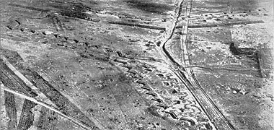
Reasons for Success and Failure
Successes
The allies were well prepared with over 700,000 men
The allies had strong strategies to attack the Germans by surprise, such as preparing at night
The Canadian Corps were capable of building bridges on canals for tanks
Failures
The Germans defense was strong with the Hindenburg Line which was heavily equipped with machine guns

Slide 9
Canada’s Contribution
Over 100,000 Canadian troops fought in the Hundred Days
The Canadian Corps destroyed parts of the Hindenburg Line
The Canadians fought hard in the Battle of Amiens
The Canadian Corps helped capture the town of Cambrai
The Canadians played a key role for helping the Allies reach Mons

Slide 10
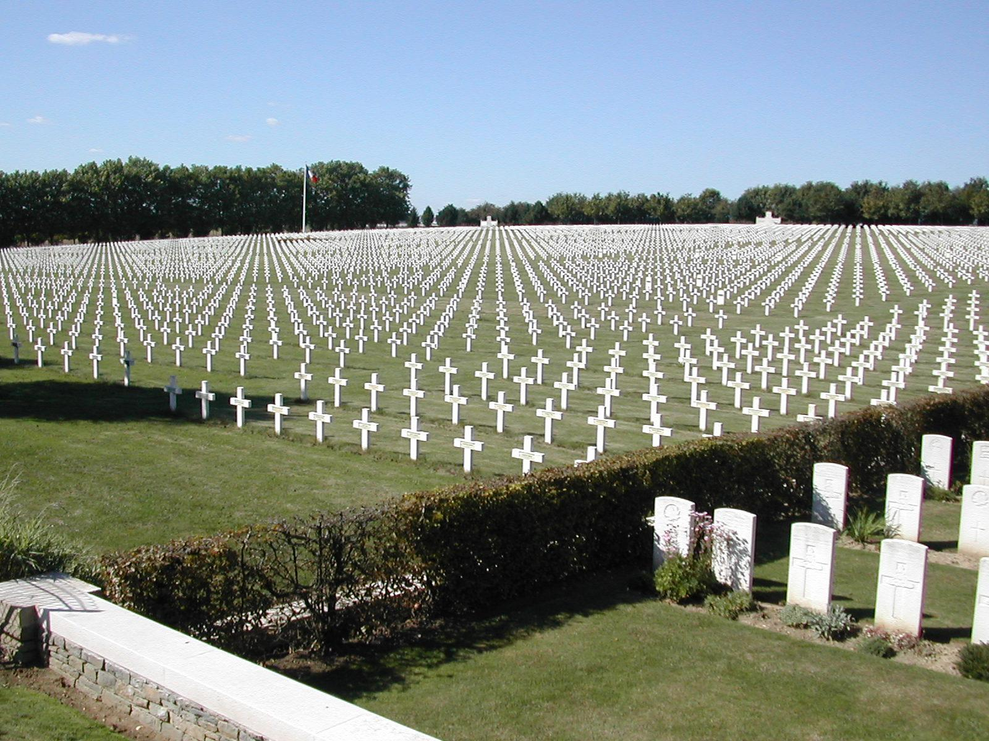
Total Costs
-700,000 total Allied deaths
-6,800 Canadian Troops died
-39,000 wounded
-760,000 German Troops died overall
-6,700 Artillery Pieces captured

Slide 12
Sources
http://www.veterans.gc.ca/eng/remembrance/history/first-world-war/canada/canada15
https://en.wikipedia.org/wiki/Canada's_Hundred_Days
http://mskandres.weebly.com/ss11.html
https://en.wikipedia.org/wiki/Hundred_Days_Offensive
https://www.thestar.com/news/world/ww1/2014/08/01/world_war_1_encyclopedia_the_hundred_days.html

