Slide 1
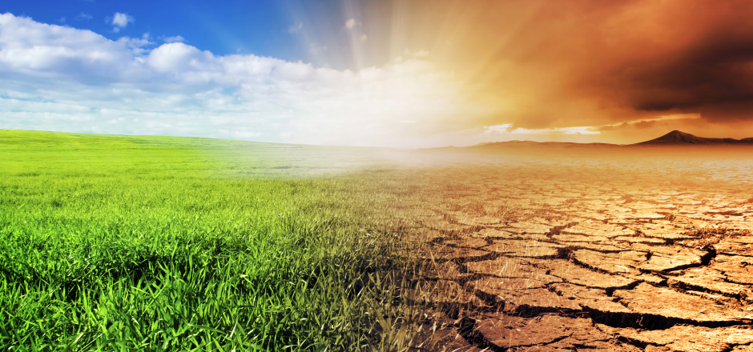
Climographs

Slide 2
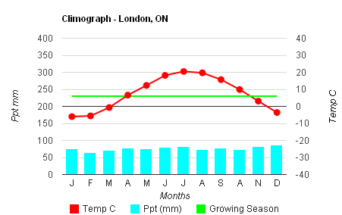
What is a Climograph?
A graph showing basic information about the climate of a specific region.
Contains a line graph depicting average monthly temperature.
Contains a bar graph depicting average monthly precipitation
Also shows the growing season – the part of the year when average monthly temperature remains above 5°C.

Slide 3
The red line graphs monthly averages of 24-hour temperature and is read on the right axis
Growing Line at 5°C
The blue bars chart monthly precipitation totals and are read on the
left axis
J F M A M J J A S O N D

Slide 4
Interpreting Climographs
What can we tell by looking at a climograph?
Temperature range:
The coldest and warmest average temperatures experienced in a location.
Eg, Winnipeg: -17°C to 26°C
Total annual precipitation:
The total amount of precipitation for all twelve months.
Eg, Abbotsford: 1538mm
Growing season:
The number of months which have an average temperature of 5°C or warmer
Eg, Iqaluit: 1 month, July

Slide 5
What is the temperature range in London, ON?
J F M A M J J A S O N D

Slide 6
What is the growing season in London, ON?
J F M A M J J A S O N D

Slide 7
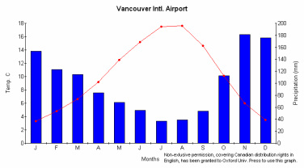
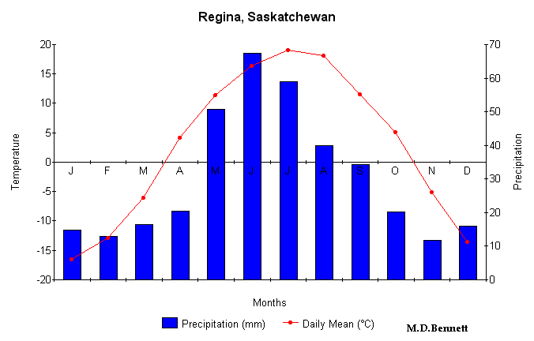
Which location would you rather live in if you…
Hate rain during the summer?
Love snow?
Love extreme temperatures (cold winters and hot summers)?
Are a farmer?

Slide 8
How does geography affect climate?
Factors:
Latitude:
Location in terms of north and south
Elevation:
Height above sea level
Bodies of Water:
Proximity to large bodies of water

Slide 9
Latitude
Temperature is directly affected by latitude:
The intensity of the Sun’s light that an area receives changes with latitude.
At the North Pole and South Pole, the sun is always low in the sky, making it cooler.
At the Equator, the Sun is always high in the sky, making it hotter.
Areas around the Equator don’t have seasons that vary the weather because the Sun’s height in the sky remains fairly consistent throughout the year.

Slide 10
Elevation
Elevation affects climate:
Climates become cooler and the cold season lasts longer as elevation above sea level rises.
This would be the case for mountains and high elevation plateaus. (eg. Tibet)

Slide 11
Bodies of Water
Proximity to bodies of water affects climate:
Water is one of the least reflective surfaces on the Earth.
Water absorbs extra heat during warm periods and releases it during cooler periods.
Water contributes moist, cool air through evaporation.
This means that coastal areas are generally wet and have milder temperature differences between seasons.

Slide 12
Examples of extreme climates…

Slide 13
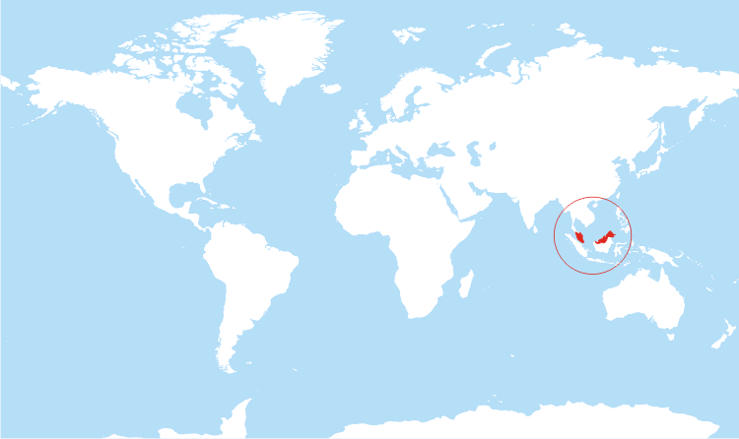
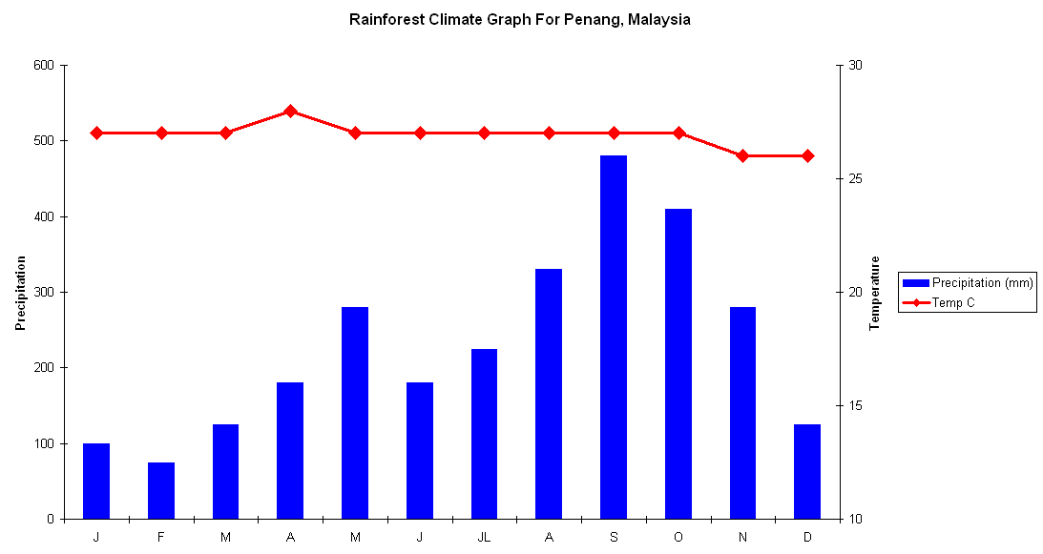
Rainforest Climate (Malaysia):
Found near the equator
Consistent warm temperature
Lots of precipitation (2500 mm)

Slide 14
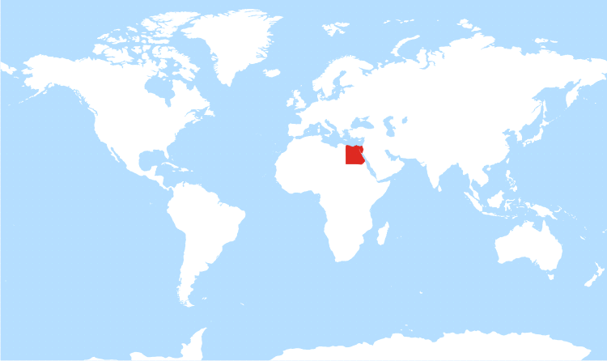
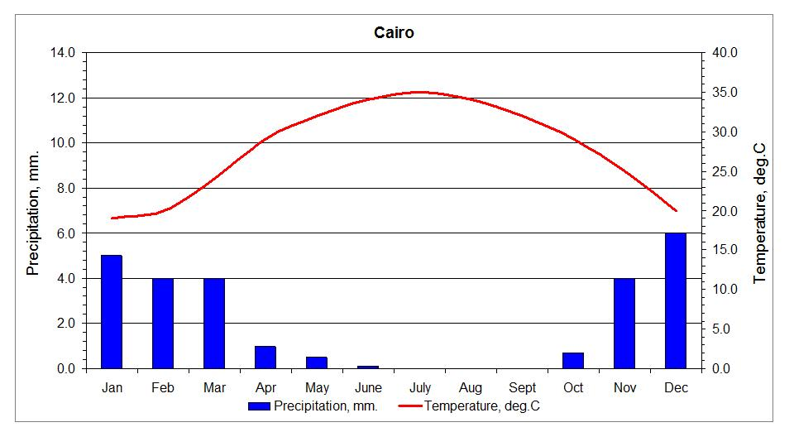
North Africa
Sahara Desert
Very little precipitation
Annual average temperature in the 20 s (°C )

