Slide 1
Integrating quotations (APA)

Slide 2
In-text Citations
The info you MUST have for in-text citation
  Author, year, page number(s)
  (Smith, 1995, p. 73-4)
BUT Paraphrasing (not using a direct quote)
  Author, year… don’t need page number.

Slide 3
In-text Citations
More than 4 authors = first author + “et al.”
  ***NO period after et***
Instead of: “(Petterson, Boeser, Horvat, Edler, & Tanev, 2019).”
It becomes: “(Petterson et al., 2010).”
But, 4 authors = (Sedin, Sedin, Burrows, & Kesler, 2010)

Slide 4
Short Quotations
One sentence maximum, please!
  In Smith’s (1995) article, she argues that “the rate of second hand smoke in public gathering places like bars and restaurants is three times the rate of private residences” (p.73).
  →You are three times more likely to inhale second hand smoke in a public gathering place than a “private residence” (Smith, 1995, p.73)

Slide 5


Slide 6
The main Ideas of the video
Never quote for the sake of quoting
Use your quotes to strengthen your paper
Make sure your quote makes sense

Slide 7
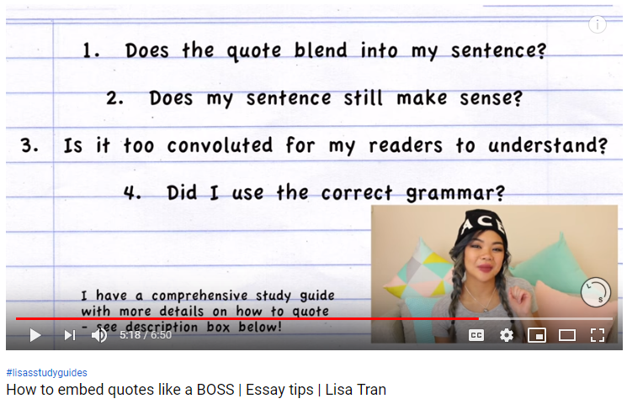

Slide 8
Answering these questions in one fell swoop…
RULE OF THUMB: take out the quotation marks… does your sentence still make sense?
Punctuation
Verb tenses
Subject-verb agreement
→Are these consistent throughout your sentence?

Slide 9
Shorter Quotation = more powerful!
Ellipses and Square Brackets
  Ellipses = condense
  Square Brackets = anything you add to make sense
Ex. “I am myself. I am my own expert because I’ve walked a mile in my own shoes. No one can tell me who I am.”
→ By the end of the novel, she is “[herself]… no one can tell [her] who [she is]” (Hein, 2019, p.1).

Slide 10
Quality of quotes, not quantity of quotes
“Never quote for the sake of quoting,” because your teacher isn’t looking for “4 quotes per paragraph” (Tran, 2016).
Use a quote only when…
  The writer’s words are more memorable and interesting
  The writer’s language can better convey an idea than you can
  You want to add authority to your paper

Slide 11
Paraphrasing = no direct quotation
“The rate of second hand smoke in public gathering places like bars and restaurants is three times the rate of private residences” (Smith, 1995, p.73).
Can become…
According to Smith (1995), second hand smoke is three times stronger in public gathering places than in private residences.

Slide 12
Three types of quote integration
Begin with quote (not strong)
  “She always felt the center of her heart go hard” demonstrates how Mrs. Wilmot appears a loving mother to the rest of the world, while inwardly feeling little for her children (120).
Begin with explanation (stronger)
  Even though Mrs. Wilmot appears to love her children to the rest of the world, “when her children were present, she always felt the center of her heart go hard” (120).
Quote inserted in the middle (strongest)
  Mrs. Wilmot “always felt the center of heart go hard” when her children were present, but to the rest of the world, she appears to be a loving mother.

Slide 13
2 minute stretch
On one condition:
  Come back, phones away, notes out

Slide 14
Essay Proposal Assignment due Date: __________
In 50-100 words, tell me what your essay is going to be about
4 sources
  3 academic sources for your argument
  1 source against your argument
You will write minimum 2 sentences for each article (no more than 75 words)
  Sentence 1: briefly summarize the article
  Sentence 2: how you will use the article in your essay
You will be marked on (out of 6):
  1) Your ability to properly cite information (APA format) – 75%
  2) Your ability to summarize your essay and your sources – 25%

Slide 15
My first essay proposal, English 135 @ UVic

