Slide 1
Introduction to Poetry
The Smile Method and analyzing vs summarizing

Slide 2
Review Terms From Grade 9,10, and 11
Please write the following terms on your vocabulary sheet. They should follow story beginning types, as well as types of characters (there will be a quiz soon).
Remember that this is for your own study purposes. You do not need to write down definitions if you don’t need to, but write down the word so you can remember that we’ve covered it.
Structure Terms:
Stanza (Verse): a group of lines in a poem
Line: a line in a poem

Slide 3
Review Terms From Grade 9,10, and 11
Please write the following terms on your vocabulary sheet. They should follow story beginning types, as well as types of characters (there will be a quiz soon).
Metaphor: A direct comparison between two dissimilar items.
______ IS ________
Extended Metaphor: the comparison is stretched through an entire stanza or poem, often by multiple comparisons of unlike objects or ideas.
Simile: A comparison between two dissimilar items by using “like” or “as”.
Figurative Language*: The imaginative language that makes a poem rich to a reader. Figurative language often relies on comparison devices like simile, metaphor, and personification to make the point. Figurative language is the opposite of literal language.

Slide 4
Review Terms From Grade 9,10, and 11
Please write the following terms on your vocabulary sheet. They should follow story beginning types, as well as types of characters (there will be a quiz soon).
Sound Terms:
Rhyme: When two or more words end with the same sound
Internal Rhyme: When two or more words rhyme within the same line of poetry. For example, “Once upon a midnight dreary, while I pondered weak and weary” is an example of internal rhyme.
End Rhyme: When the ends of two lines of poetry rhyme
Rhyme Scheme: The pattern of rhyme in a poem
Alliteration: When two or more words begin with the same sound

Slide 5
Review Terms From Grade 9,10, and 11
Please write the following terms on your vocabulary sheet. They should follow story beginning types, as well as types of characters (there will be a quiz soon).
Structure Terms:
Hyperbole: Deliberate exaggeration for effect
Personification: A form of figurative language in which something that is not human is given human characteristics
Oxymoron: Oxymoron*: An oxymoron is a pair of single word opposites placed side by side for dramatic effect. A contradiction in terms. For example, “cold fire” or “sick health” or “jumbo shrimp”.
Juxtaposition*: The deliberate placing together of two or more thoughts, images or other elements that emphasize each other through their side-by-side placement. Juxtaposition is a form of contrast.

Slide 6
Review Terms From Grade 9,10, and 11
Please write the following terms on your vocabulary sheet. They should follow story beginning types, as well as types of characters (there will be a quiz soon).
Structure Terms:
Connotation*: The unspoken, unwritten series of associations made with a particular word. For example, the word “dog,” depending on how it is used, might connote faithfulness, loyalty, and devotion. On the other hand, the word “dog” could connote viciousness.
Denotation*: The literal meaning of the word that a person would find in the dictionary.
Mood*: The emotion of the poem. The atmosphere. The predominant feeling created by or in the poem, usually through word choice or description.
Voice*: Voice is the personality of the writing, the specific characteristics that make the writing unique. The voice of a piece of writing is assessed in terms of style and/or tone. Every writer/narrator/speaker has a unique and recognizable voice.
Tone*: The narrator’s attitude toward the subject of the poem and, sometimes, toward the reader of the poem. Tone is NOT THE SAME AS MOOD, although the two can overlap.

Slide 7
Review Terms From Grade 9,10, and 11
Repetition*: Deliberately repeated words, sounds, phrases, or whole stanzas. Repetition is used to make a point in the poem.
Symbol*: Something that represents something else. For example, a dove often represents the concept of peace.

Slide 8
Summary Vs Analysis
Summary refers to the process of condensing someone else’s work, specifically the main ideas, in your own words and doing justice to the author’s original intentions.
It answers the questions of who, what, where, when, why, and/or how in that particular work.
* Summarizing is a valuable skill in many research essays and journalism; however, it is not the point of literary analysis.

Slide 9
Summary vs Analysis
Analysis, in contrast, features original thought from you, the writer.
It examines the deeper meaning of the summarized content. This examination includes—but is not limited to—the work’s purpose, theme, and figurative language, as well as patterns, pros and cons, and cause/effect relationships
Analysis answers the deeper questions how and/or why the theme or patterns in the text are important and/or relevant.
This is what you are hoping to achieve in a good literary paragraph

Slide 10
GOOD LITERARY WRITING ADDS SOMETHING NEW TO THE CONVERSATION. It does not repeat what has already been said.
You should use your instincts and the literary devices at your disposal to make these arguments…

Slide 11
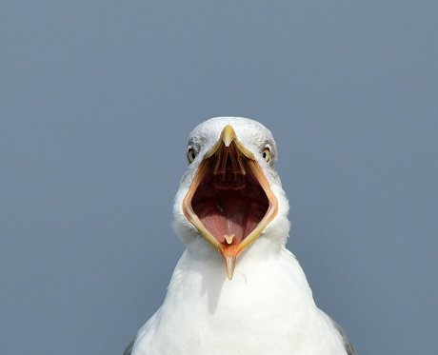
Watch how Jermaine listens to Brett’s song and ANALYSES it. He is looking for deeper meaning.
FLIGHT OF THE CONCHORDS
https://www.youtube.com/watch?v=zSvpAEx2fLE

Slide 12
Lets Do it together…
1) Watch Alicia Key’s slam poetry presentation of ‘Prisoner of Words’ and explore its meaning.
2) Annotate using the smile method from the worksheet that you have been given.
3) A good annotation has writing All over it. Fill the page. You will be handing this in with your writing assignment next class.

Slide 13
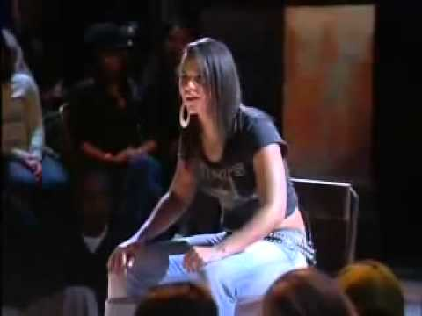
Annotate Alicia Keys’ ’ ‘P.O.W’
https://www.youtube.com/watch?v=_oTwrYKIo-s

Slide 14
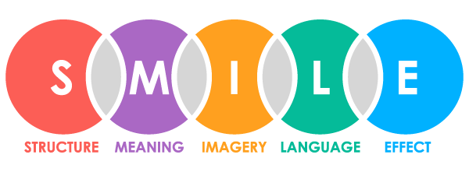
REMEMBER

Slide 15
DAY Two
Vocab and ‘Not Ready to make Nice’

Slide 16
Review Terms From Grade 9,10, and 11
Please write the following terms on your vocabulary sheet (there will be a quiz soon).
Free Verse*: Modern poetry that has no regular pattern of rhythm, rhyme or line length. Free verse poems experiment with words to create images for the reader.
Blank Verse*: Unrhymed iambic pentameter. All sonnets, Shakespearian plays and the King James version of the Bible are written in blank verse. Unrhymed iambic pentameter is said to closely mimic the cadences of natural speech. See below for more information on iambic pentameter.
Iambic Pentameter*: A line of poetry that is ten syllables in length. The syllables follow a pattern in which an unstressed syllable is followed by a stressed one. The words “giraffe” and “destroy” are iambs. An iamb is two syllables, and “penta” means 21 five, so five iambs in a row = iambic pentameter.

Slide 17
Review Terms From Grade 9,10, and 11
Rhythm*: A pattern of sound in a poem; it may be a regular or irregular pattern. Rhythm is the musical beat of the poem, and some poems are more musical than others.
Metre (meter)*: The regular beat of a poem. There are different kinds of meters, depending on the syllable pattern in the line of poetry. Different syllable patterns, and different numbers of patterns, have different names. For example: dimeter. trimeter, tetrameter, pentameter, hexameter, heptameter, and octameter. (NT).
Syntax: Word order—the way words are put together to form phrases, clauses or sentences in a poem. Sometimes poets play with syntax to increase the richness of their figurative language or to make a line of poetry work into a particular rhythm.

Slide 18
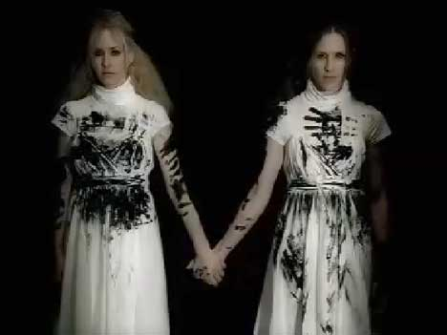
Annotate the Dixy Chicks’ ‘Not Ready to Make Nice’
https://www.youtube.com/watch?v=pojL_35QlSI

Slide 19
ASSIGNMENT: Writing Prompt
Write a persuasive synthesis paragraph expressing the importance of speaking your mind (either positive or negative).
You must use both examples in your argument.

Slide 20
Writing Literary Analysis
Formal Writing
Is present tense when discussing books, films, poems, songs etc.
Uses active voice
Is written in the 3rd person
Writes in formal voice, avoiding terms like “In this day and age,” “In olden times,” “In the world today,” “In order to,” and “Back in the day”
** “A lot” and “a lot of” (and their other forms) are informal. Use “many” or “much” instead.
Does not use:
Contractions: can’t, won’t
Slang
Use clichés
Ask questions

Slide 21
Writing Literary Analysis
Remember that a quotation never “shows” anything; use a powerful, connotative verb instead to discuss quotations. The author does not “say” anything; he or she argues, writes, displays, posits, etc
Poetry Quotations:
Never start a sentence. Transition into it.
Have a single (‘) quotation mark at the beginning an end.
Divide different lines using (/)
Do not have (.,;:) at the end (before the source).
Are sourced (last name, lines). Ex. (Keys, 7-9).

Slide 22
Paragraph Formatting
Hook- Catch the attention of the reader
Question, Statistic, Quote, Fact, Statement (1 sentence)
Thesis- What is your paragraph about?
- Must include: argument, author(s), titles (1-2 sentences)
3 Body Points-
Remember to: point, proof, explain (6-9 sentences; 2-3 ea)
Conclusion- Re state the thesis in a different way. (1-2 sentences)
9-14 sentences.

