Slide 1
Fashion and Makeup in Ancient Egypt
By: Lexi Scherr, Ruth Kondewa and Catherine Palfy

Slide 2
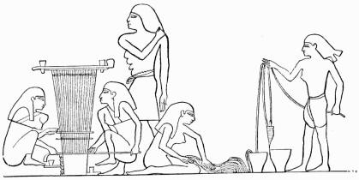
How Clothing was made
Most clothing was made from linen
The linen was harvested from flax
Flax was softened in water and then separated into fibres
The flax was then beaten and spun into thread
The final step was weaving the thread into cloth

Slide 3
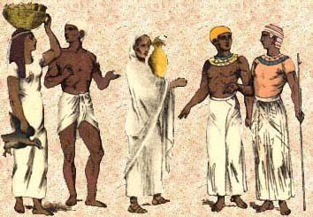
Commoner Clothing - Men
Old Kingdom: Shorter wrap around skirt tied at the waist with a belt
Middle Kingdom: Calf length skirts tied around the waist and sometimes the legs
New Kingdom: wrap around skirt, tied at the waist with a belt. Garments were often pleated
If not wearing a skirt, men would wear a Kalasiris

Slide 4
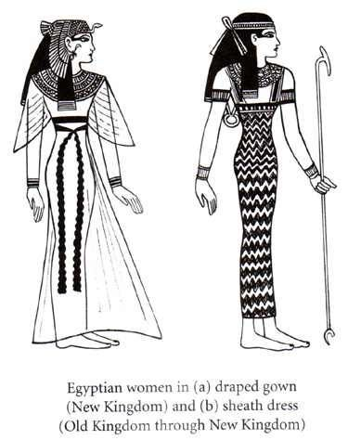
Commoner Clothing - Women
Working women most often wore a long linen dress called a Kalasiris.
The Kalasiris worn by women could cover one or both shoulders, or have shoulder straps
The dress may fall anywhere between the calf or the ankles
Could be loose or tight, often worn with a belt that held the folds of cloth together
Slave girls wore jewelry and small panties (little to no clothing provided for them)

Slide 5
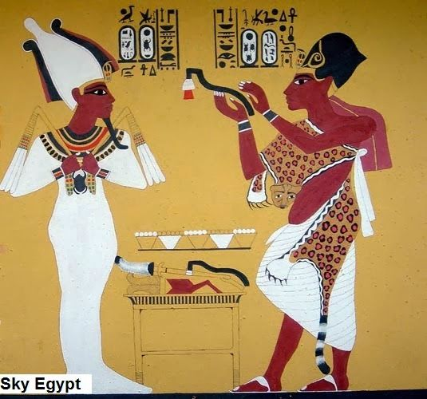
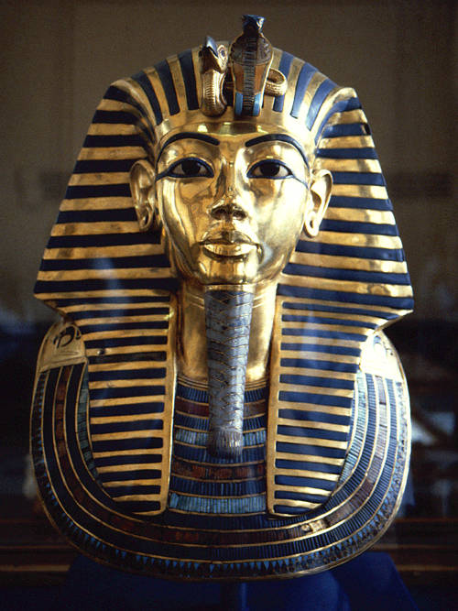
Royal Clothing - Pharaohs
To display their power and association with the gods, the Pharaohs wore different clothes than the nobles and the common people.The royal headdress called the Nemes was an important royal emblem.
Pharaohs wore a pleated skirt with the pleated section toward the front of their body. They would also wear leopard skins over their shoulders and had a lion tail hanging from their belt.

Slide 6
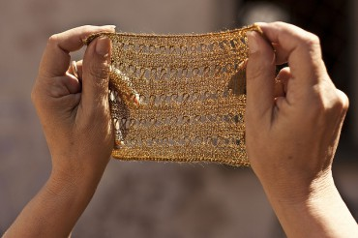
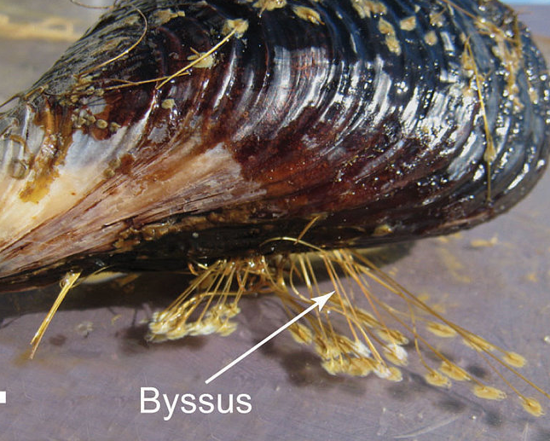
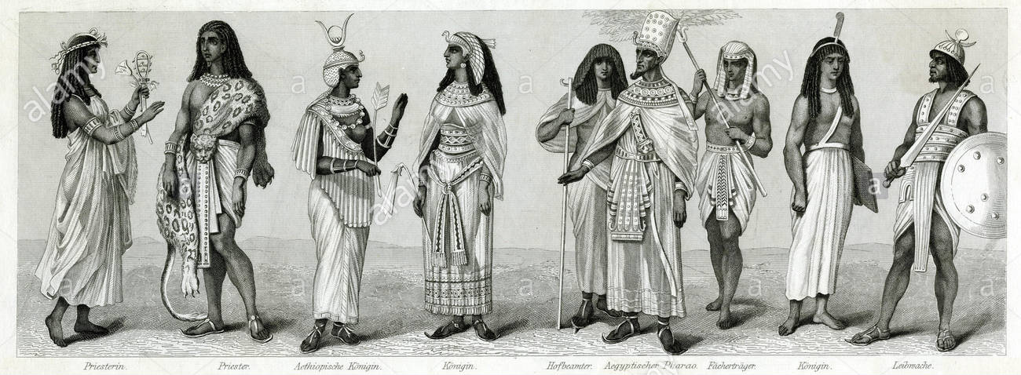
Royal Clothing - Priests + Priestesses
Most of the linen worn by the high class was made of Byssus
Byssus is a form of linen made from the delicate strings made by molluscs (mussels) to attach themselves to rocks, byssus silk is now very rare and hard to get
Nobles often wore the Khat or head cloth

Slide 7
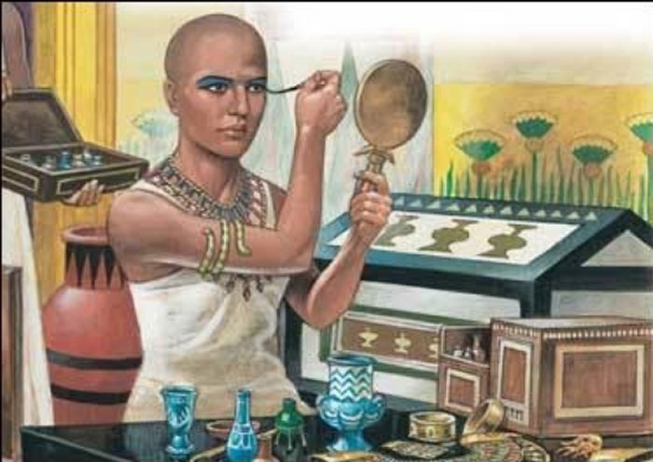
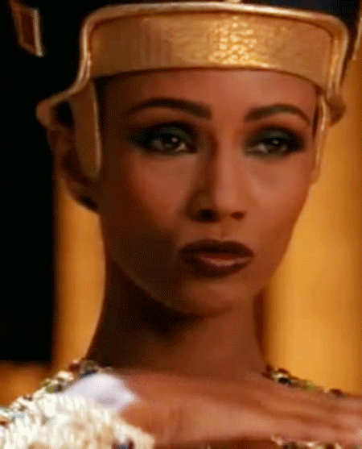
How makeup was made:
As early as 4000 B.C., Egyptians used materials in order to design makeup. Some of the common cosmetics in Ancient Egypt included:
Malachite, a copper ore, provided the green eye makeup color so greatly favored at the time
Kohl, used to draw thick, distinctive black lines, gave an almond shape to the eyes
Red ochre, was used as rouge or lip color
Henna, was widely used to stain the fingertips and toes

Slide 8
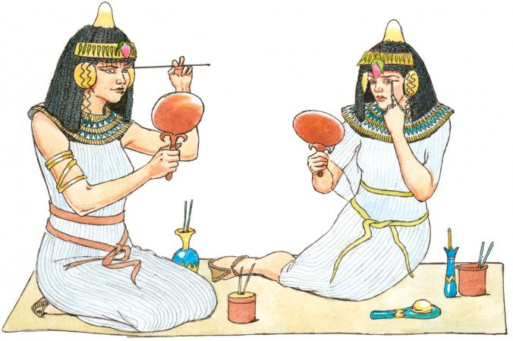
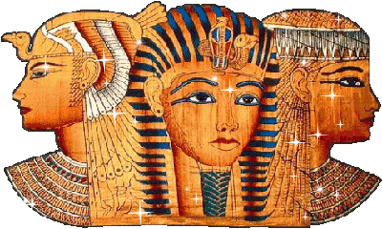
How they wore the makeup:
Egyptians mostly used galena (more commonly known as kohl) and malachite powder (a green mineral) for eye makeup.
Galena was a black paint that shielded eyes from the sun, while malachite powder made the eyes appear larger and protected those who wore it.
Both were applied using ivory, wood, or sticks made of metal.
Though the eyes had the highest importance, men and women drew attention to the lips as well.
This was typically done with the use of red ocher.
It was often applied alone but in many cases was mixed with resin or gum for a longer lasting appearance.

Slide 9
Thanks for listening

Slide 10
Bibliography
https://www.historyonthenet.com/egyptian-clothing
https://www.historymuseum.ca/cmc/exhibitions/civil/egypt/egcl06e.html
http://www.historyofclothing.com/clothing-history/egyptian-clothing/
https://www.ancient.eu/article/1037/fashion--dress-in-ancient-egypt/

