Slide 1
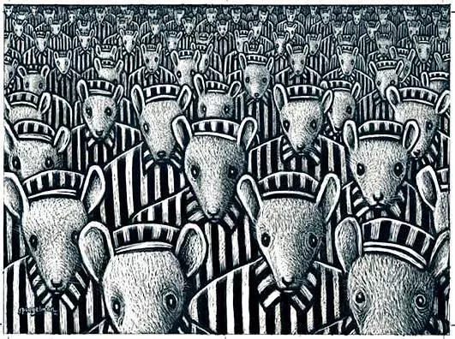
DOUBLE ENTRY JOURNAL PROMPTS

Slide 2
Journal Response
One

Slide 3
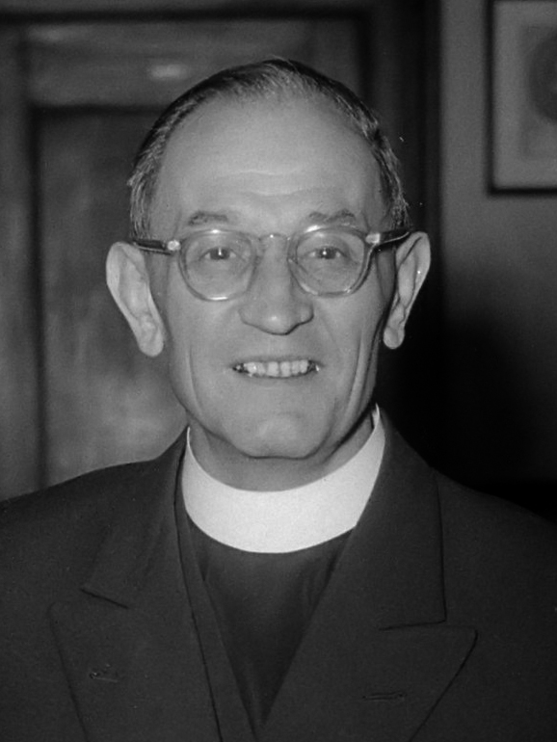
Martin Niemöller
‘First They Came for the Socialists’
A national conservative and initially a supporter of Adolf Hitler
Became one of the founders of the Confessing Church, which opposed the Nazification of German Protestant churches.
Oopposed the Nazis' Aryan Paragraph, but also made remarks about Jews that some scholars have called antisemitic.
He was imprisoned from 1938 to 1945 and narrowly escaped execution.
After the war he expressed his deep regret about not having done enough to help the victims of the Nazis.
https://en.wikipedia.org/wiki/Martin_Niem%C3%B6ller

Slide 4
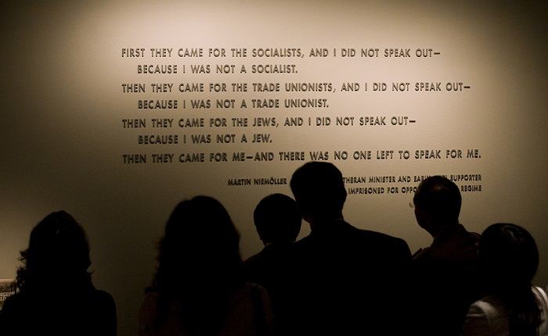
First they came for the Socialists, and I did not speak out—
Because I was not a Socialist.
Then they came for the Trade Unionists, and I did not speak out—
Because I was not a Trade Unionist.
Then they came for the Jews, and I did not speak out—
Because I was not a Jew.
Then they came for me—and there was no one left to speak for me.

Slide 5
Journal Response
Two

Slide 6
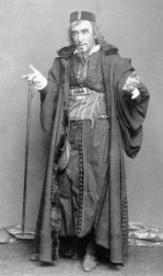
H
William Shakespeare
The Merchant of Venice (Act III, scene ii)
: Act III, scene I
The Merchant of Venice, features a Jewish moneylender named Shylock. He lends money to another character: Antonio, whom Shylock has a grudge against since Antonio has a reputation for racism against other Jews in the community.
Antonio agrees to an interest free loan; however, if the loan goes unpaid he will give Shylock a pound of his own flesh. Antonio is unable to pay back the loan and the community is trying to convince Shylock to “let it go,” despite the legally binding agreement…
Henry Irving playing Shylock

Slide 7
H
53
54
55
56
57
58
59
60
61
62
63
64
65
66
67
68
69
70
71
72
To bait fish withal. If it will feed nothing else,
it will feed my revenge. He hath disgraced me and
hindered me half a million, laughed at my losses,
mocked at my gains, scorned my nation, thwarted my bargains, cooled my friends, heated mine
enemies—and what’s his reason? I am a Jew. Hath
not a Jew eyes? Hath not a Jew hands, organs,
dimensions, senses, affections, passions? Fed with
the same food, hurt with the same weapons, subject
to the same diseases, healed by the same means,
warmed and cooled by the same winter and summer as
a Christian is? If you prick us, do we not bleed?
If you tickle us, do we not laugh? If you poison us,
do we not die? And if you wrong us, shall we not revenge?
If we are like you in the rest, we will resemble you in that.
If a Jew wrong a Christian, what is his humility? Revenge.
If a Christian wrong a Jew, what should his sufferance be by Christian example? Why, revenge. The villainy you teach me I will execute—and it shall go hard but I will better the instruction.

Slide 8
Journal Response
Three

Slide 9
H
Disney’s ‘Education for Death’
Propaganda film made in 1943.
Based on the book by Gregor Ziemer.
Made for US gov’t to pay off debt from Fantasia.
Like most propaganda it is extremely biased.
Uses fear, emotion, and humour to persuade the viewer.
https://www.youtube.com/watch?v=6vLrTNKk89Q

Slide 10
H
Disney’s ‘The Fuehrer’s Face’
Made for the American government.
An Oscar award winning short film featuring Donald Duck having a nightmare about working in a German ammunitions factory.
https:/www.youtube.com/watch?v=5LYD0Fzf1LU

Slide 11
Journal Response
Four

Slide 12
H
Marcel Petiot: The Murderous Paris Doctor https://www.medicalbag.com/despicable-doctors/french-doctor-in-world-war-ii-was-a-serial-killer/article/472409/
Read the article in groups and come up with 3 things that catch your attention.
Discuss in groups.
Write a journal entry.

Slide 13
Journal Response
Five

Slide 14
H
Canada and the Holocaust
Read one of the sections of the following article in pairs.
Choose 3 important facts from your section.
Present your facts to the class.
Does what you learned today match the idea that you have about Canada? Why or why not?
http://www.thecanadianencyclopedia.ca/en/article/holocaust/

