Slide 1
What is Fear? Monster Theory and Allegory

Slide 2
The contributors to Monster Theory consider
Beasts
demons
freaks
and fiends
… as symbolic expressions of cultural unease that pervade a society and shape its collective behavior…

Slide 3
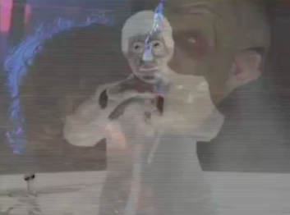
https://www.youtube.com/watch?v=Ve2Nd43qWyk

Slide 4
“There are two horror stories that we can tell…”
and we can imagine ourselves around the campfire listening to the tribal elder or witch doctor or preacher or whoever it is telling us these things at night.
The first thing he tells us is about where ‘evil’ is, and he says,
‘‘Evil is out there,’’
and he points beyond the campfire, to the darkness in the woods and the noises we hear at night; the wolves that come and drag us off; those beasts out there; the ‘other’ - the other tribe, the other people - the ones who are different, different color, their eyes are different from ours; those are the evil ones out there.
In different countries they have different clothes, different ideologies, or they may be any force of nature we cannot control, so this unifies the tribe.
That’s the first story of horror…

Slide 5
The second one is the same setup, but the tribal elder says…
‘‘Let me tell you where the evil is: the evil is here,’’
… and he points to himself. And he says,
‘‘It’s in the human heart.’’
That’s a harder story to tell - that we are all part evil, monsters and devils - because the audience is always going to respond to the ‘other.’ It unifies us as a tribe - that’s the way we are designed.
We see things in order to find where the predator comes from; it’s survival instinct over all the time we have evolved. So a lot of this is unconscious in a way. We’re driven by it, and our parents reinforce it, our religion reinforces it –
‘Watch out!’ Watch out for those predators, because they are all around”
- John Carpenter

Slide 6
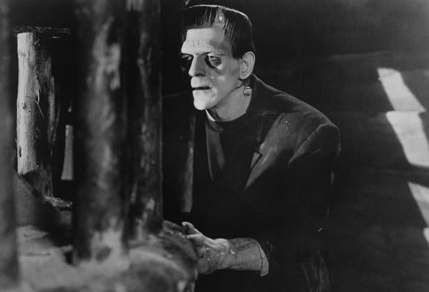
Monster Culture (Seven Theses) Summary:
Jeffrey J. Cohen explains that we understand culture/society though the types of monsters
that are featured

Slide 7
Thesis 1: The Monster’s Body is a Cultural Body
Monsters correspond with a culture at a particular moment
Fear, desire, and anxiety all revealed
It is a projection/ a “warning”

Slide 8
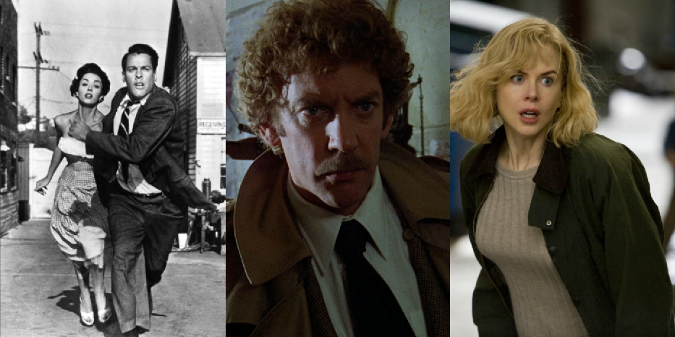
https://www.youtube.com/watch?v=vc_0dlmSq7I

Slide 9
Like many other films of the decade, Invasion deals with three issues: the definition of normal and abnormal behavior; the legitimate authority to label behaviors as abnormal or deviant; and the negative effects of conformity, apathy, and complacency.
The movie advocates independent judgment, common sense, intuition, and self-reliance, and shows suspicious toward anyone in a position of power or professional expertise. Invasion, like Capra's movies of the Depression era, singles out the role of an exceptional individual, a charismatic leader, in preventing society from dehumanization, from gradual transformation into an aggregate of unfeeling robots.
Sleep is the metaphor used to convey mass complacency and conformity. The pods take over human beings when they are not alert, when they are (literally or figuratively) asleep, thus passive.
Here are the years this film has been made in. What you you notice about them? (Think Social Studies).
1958
1978
2007

Slide 10
Thesis 2: The Monster Always Escapes
Monster is never truly destroyed/defeated; something is always left over.
Monsters = fear; fear cannot be physically conquered/literally killed.

Slide 11
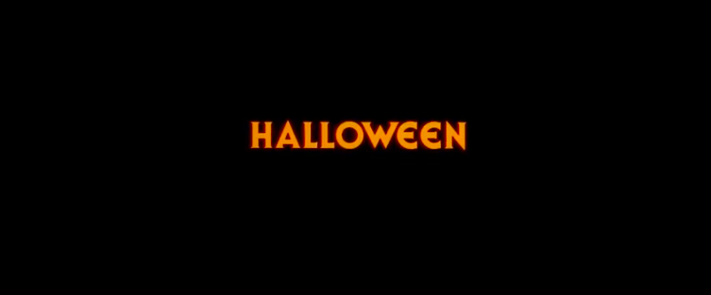
https://www.youtube.com/watch?v=RTsRR43AUMY

Slide 12
Thesis 3: The Monster is the Harbinger of Category Crisis
The monster threatens conformity
The monster is in 2 categories at once (or… none?)
Dracula was promoted as the “strangest love story ever told.”
What they don’t tell the audience is that the love story isn’t really between “the dead” and Mia, but really between the dead and John Harker.
Yes, Dracula seduces Mina, but he also lures in Harker.
The imagery of fangs penetrating skin is an obviously sexual act, and Dracula bites men (likely John).

Slide 13
So is Dracula an allegory for the “homosexual threat” ?
The writer of Dracula, Bram Stoker is believed to be LGBT. There are love letters written by him to his idol Walt Whitman.
So perhalps Dracula was not meant as a “threat” but merely a representation of the outsider that Stoker thought himself to be. It was the fears of society at the time that responded so strongly because they were not ready for these ideas.
Dracula comes into the story and threatens the (respectable) relationship between John and Mina. Dracula’s death is inevitably described almost tragically.
https://www.brainpickings.org/2019/01/09/bram-stoker-walt-whitman-letter/

Slide 14
Thesis 4: The Monster Dwells at the Gates of Difference
The monster is an “outsider”
Outsiders not the same; depends on culture/society/era (race, religion, ethnicity, sexuality, etc).

Slide 15
Thesis 5: The Monster Polices the Borders of the Possible
Monsters make sure we don’t cross the line; they keep us back from breaking the rules
“Curiosity killed the cat”

Slide 16
Thesis 6: Fear of the Monster is Really a Kind of Desire
Monster represents both fear and attraction (stands in both categories).
Monsters are a power fantasy… they do what we want to, but can’t.

Slide 17
Thesis 7: The Monster Stands at the Threshold… of Becoming
Monster makes us re-evaluate culture assumptions; brings out flaws in society

