Slide 1
Nefertiti and Akhenaten
By Georgia and Sydney

Slide 2
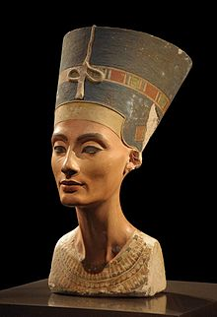
Neferneferuaten Nefertiti
Born: 1370 BC in Thebes
Died: 1330 BC
Husband: Akhenaten
Dynasty: 18th Dynasty
Title: Queen consort of Egypt 1353-1336 BC or 1351-1334 BC
Religion: Ancient Egyptian Religion

Slide 3
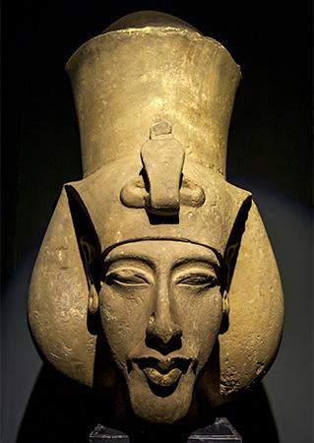
Akhenaten (Born Amenhotep IV)
Born: 1380 BC
Died: 1336 BC
Wives: Six, including Nefertiti his Great Royal Wife.
Dynasty: 18th Dynasty
Title: Pharaoh of Egypt 1353-1336 BC or 1351-1334 BC
Religion: Ancient Egypt Religion, Atenism

Slide 4
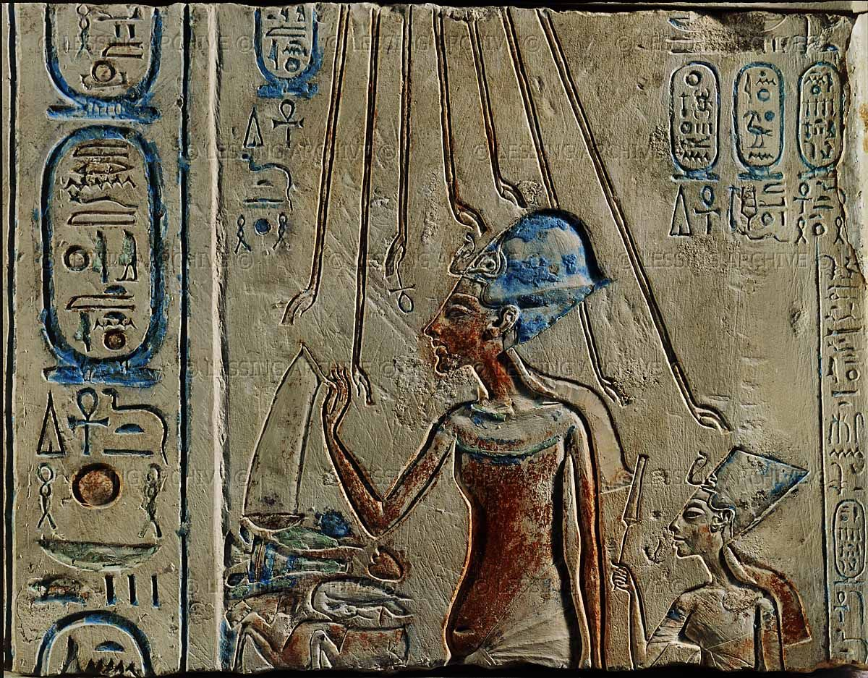
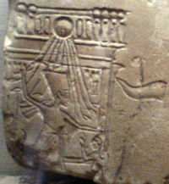
Portrayal in Hieroglyphs
In many hieroglyphs, Nefertiti is portrayed as being equal to her husband. This leads us to believe that she may have been co-regent alongside Akhenaten. She is shown riding a chariot, smiting Egypts enemies and worshiping the Aten in the manner of a Pharaoh.

Slide 5
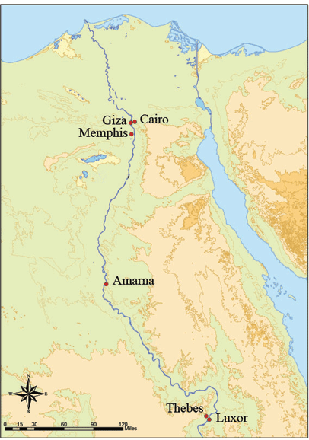
Atenism
After the death of his father, Amenhotep IV changed his name to Akhenaten (Successful for Aten).
He then decided to vacate Thebes and Memphis, which were the two main cities that previous Pharaohs had ruled at.
Set out to build a new city called Akhetaten

Slide 6
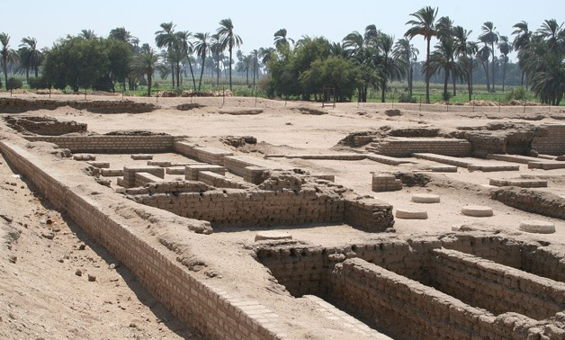
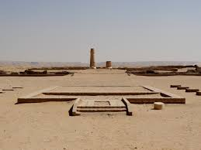
Akhetaten (Amarna)
The city was built by Akhenaten and to speed up construction of the city, buildings were built out of mud-bricks and white washed. The most important buildings were faced with local stones. Akhetaten (Amarna) was abandoned shortly after his death, when his son, King Tutankhamun returned to his birthplace in Thebes.Once abandoned the city remained uninhabited until the Roman settlement began along the edge of the Nile.

Slide 7
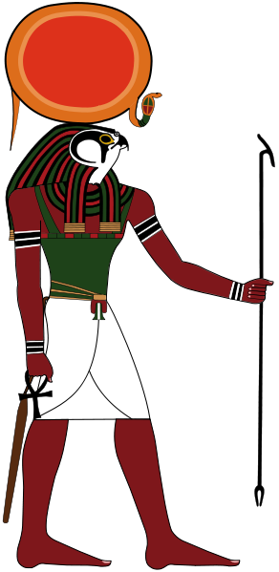
Atenism
Akhenaten set out to make major religious changes by declaring the old beliefs to be wrong.
This marked the change to a monotheistic religion.
Their new god was Aten, who is believed to have been derived from the sun disk of Re.
Aten represented the idea of creation and continued existence providing life and energy.

Slide 8
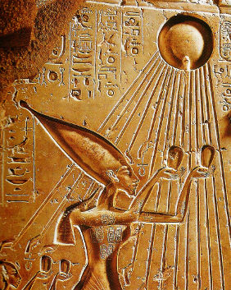
Atenism
Under Atenism, only Akhenaten could speak to Aten directly. This is unlike before when anyone could pray to the gods.
Akhenaten ordered that all other gods be erased from history.
For example, people were not allowed to build tombs for themselves to reach the afterlife. Akhenaten did not want people to worry about the afterlife, he wanted them to live in the now.
These changes would prove to be too dramatic for the people of ancient Egypt.

Slide 9
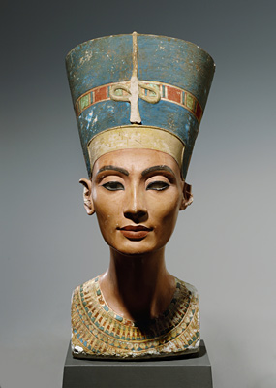
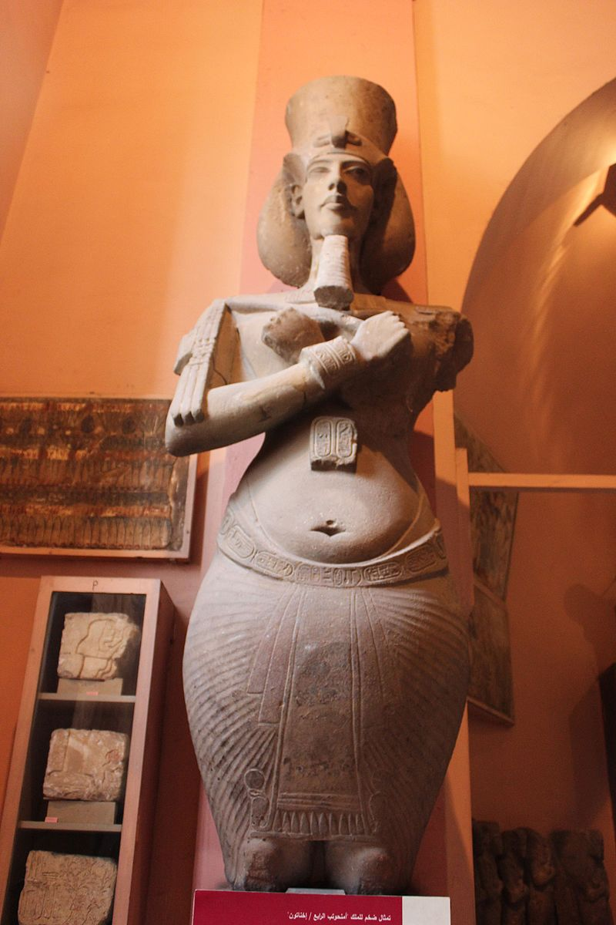
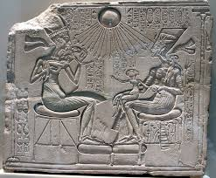
Amarna Art
The Amarna art style was adopted during the Amarna Period in the time of the New Kingdom. The Amarna style was a significant and sudden break from its predecessor, Ancient Egypt art, which was famously slow to alter. The art style is characterized by a sense of movement and activities in images. The Amarna art style had produce the very famous bust of Nefertiti.

Slide 10
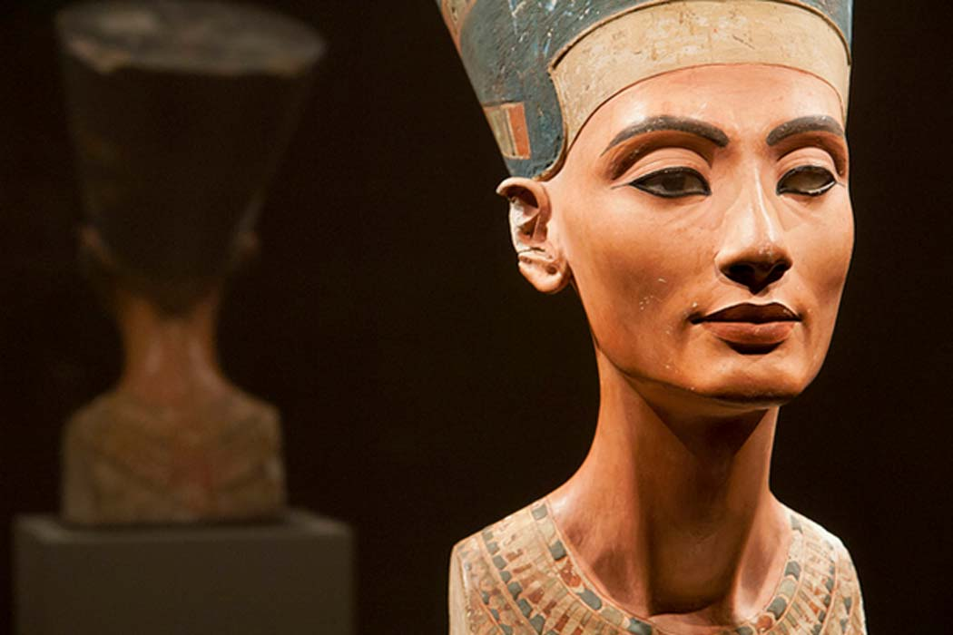
Pharaoh Neferneferuaten?
It is speculated that Queen Nefertiti became Pharaoh Smenkhkare after the death of her husband Akhenaten. It is possible that if Nefertiti kept power during and beyond Akhenaten’s last years, that she began the reversal of her husband’s religious policies.

Slide 11
Hittite Letters
In the ancient Hittite capital, Hattusa received a letter from Amarna. The letter is from an Egyptian Queen.
My husband has died and I have no son. They say about you that you have many sons. You might give me one of your sons to become my husband. I would not wish to take one of my subjects as a husband... I am afraid.
This document is considered extraordinary, as Egyptians traditionally considered foreigners to be inferior. Suppiluliuma I was surprised and exclaimed to his courtiers:
Nothing like this has happened to me in my entire life!
The identity of the which Queen wrote this letter is uncertain, but Nefertiti is a prime suspect. This letter would support the theory that she had ruled as a Pharaoh after her husband’s death.

Slide 12
Death
Nefertiti vanished from records at around year 12 of Akhenaten’s reign. Some believe that she died from the plague, or from some other cause of natural death. Another theory as to why she vanished is that she was promoted to co-regent. This would explain why Nefertiti was no longer mentioned, only Neferneferuaten.
People have speculated many different causes of death for Akhenaten. It is assumed that he died of an illness or genetic disorder. He is often portrayed as having a sagging stomach, thick thighs, large breasts and a long face. The two most probable diseases are Marfan’s Syndrome, which would explain the long features, and epilepsy, which is a theory for how multiple pharaoh’s died young.

