Slide 2
Opium in Victoria

Slide 3
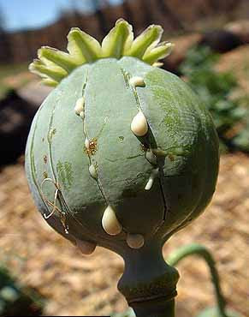
What is Opium
Comes from collecting and later drying the milky juice that comes from the seed pods of the poppy plant.
Opium has a very bitter taste and a distinct odor that is easily recognizable (if you know the odor you’re smelling).
Opium, heroin, and morphine are all derived from poppy seeds. As narcotics, they are drugs that relieve pain, relax spasm, reduce fevers and induces sleep.
It blocks messages of pain to the brain, producing euphoria and deadening anxieties and tensions. Nonetheless, these substances derived from the poppy are highly addictive and have detrimental side effects to one's health.

Slide 4
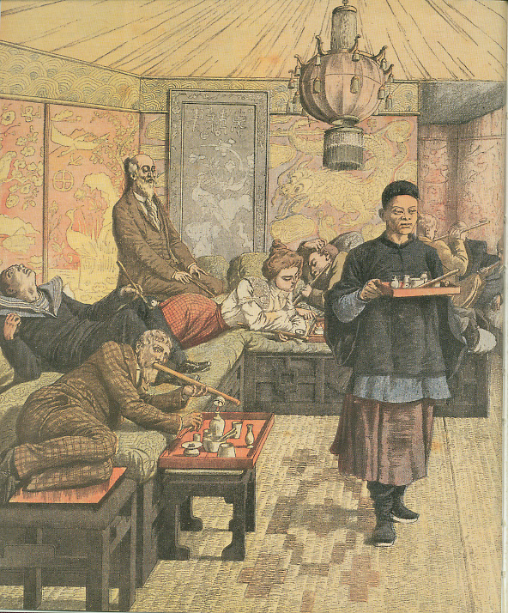
Opium was very prevalent in Victoria in the mid-to-late 1800s. At one time 13 opium factories operated in the city. Many stores sold tins of opium across the counter.
Opium dens where people smoked opium were found throughout Chinatown.

Slide 5
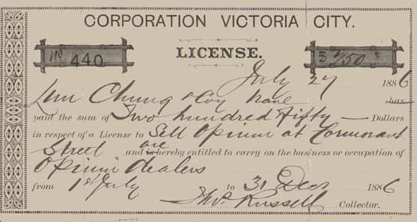
Because of the amount of revenue generated from the opium trade, a series of legislations were passed and the license fee for selling opium increased progressively.
Dr John S. Helmcken, a member of the Vancouver Island Legislature introduced a motion to license fee of $100 on opium sellers in 1865; by 1894 the annual price had gone up to $500.
All of this ended in 1908 when the Canadian government passed the Opium Act, banning the manufacture, sale, and use of the drug. The law was strengthened in 1911 with the Opium and Narcotic Drug Act and later by the Narcotic Control Act and subsequent amendments. The law governing this is now the Controlled Drugs and Substances Act, 1997.

Slide 6
Although opium was considered mostly a Chinese vice, non-Chinese used it too.
Newspaper articles and official government reports noted non-Chinese men and
women—even teenagers—sometimes went to the opium dens. Opium was also used in some western patent medicines. Laudanum (a mixture of opium and alcohol) was probably the best known of these medicines. Some people who took laudanum to soothe their pains or to sleep better became addicted, without ever having visited a Chinatown opium den.
People from all walks of life were susceptible to opium addiction.

Slide 7
Duty on Opium Imported Into British Columbia, 1872 - 1899.
Selected Years | Amount of Duty
1874 | $2,493
1875 | 4,836
1876 | 15,331
1881 | 13,668
1887 | 53,172
1889 | 101,244
1890 | 137,050
1891 | 146,760
1892 | 144,593
1894 | 91,843
1895 | 36,056
1897 | 51,580
1899 | 39,704

Slide 8
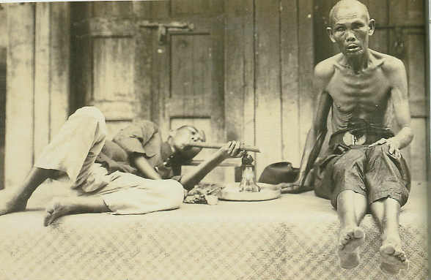

Slide 9
What are the differences between the two photographs.
Do these differences raise the possibility that the men in the first photograph may be doing
something other than smoking opium?
If so, might this be a logical reason why the title of the first photograph may have been changed?- The man in Blackline Master 3 is smoking a pipe that at first glance looks the same as the one in Blackline Master 1 (both have a flutelike shape). Look closer though and you will see there are differences

