Slide 1
The Battle of Passchendaele, 3rd Battle of Ypres
By: Caelan Scott and Andrew Pittman

Slide 2
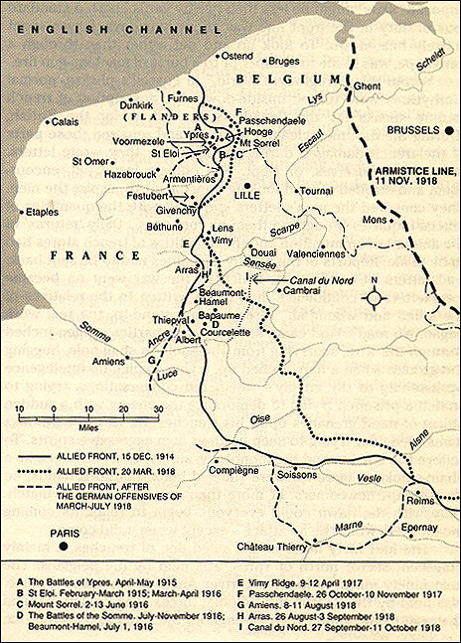
Location of the Battle
Passchendaele is located in Belgium and it lays on the last ridge east of Ypres. The battle took place on the Western Front, from July to November 1917, for control of the ridges south and east of the Belgian city of Ypres.

Slide 3
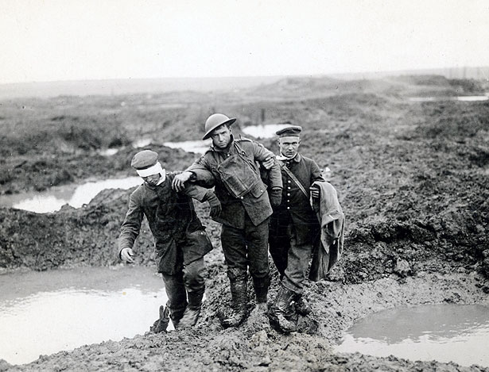
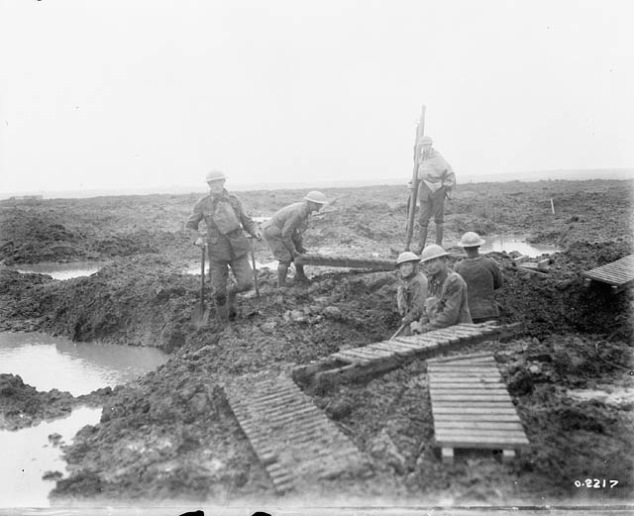
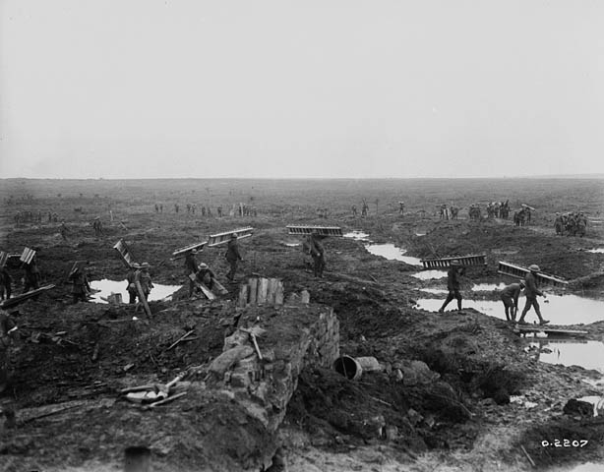
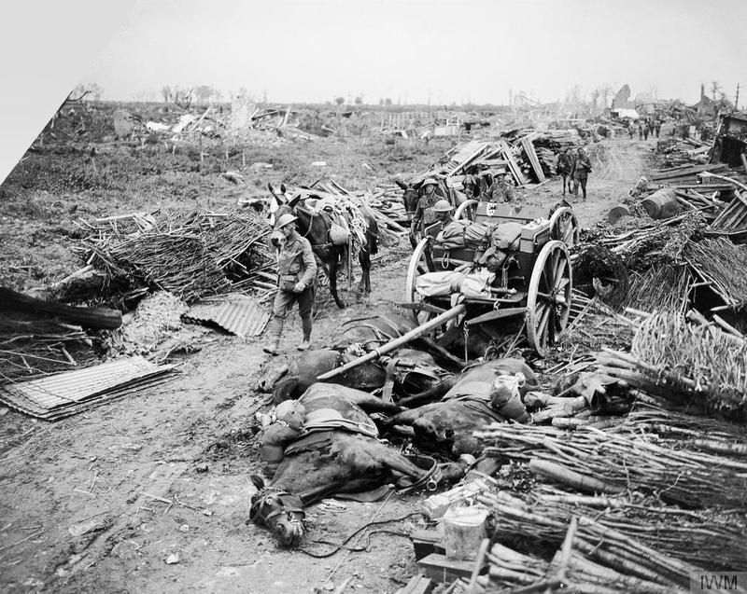
Pictures From the Battle of Passchendaele

Slide 4
Outline of the Battle:
-July 31st, 1917: Troops begin move towards the city of Ypres
-June 7th, 1917: Messines Ridge is captured -August 17th 1917: The battle at Langemark takes place, lasting 4 days
-October 12th 1917: The first battle of Passchendaele takes place
(They don’t meet their objective, but any gains at Passchendaele is good!)
-October 20-22nd 1917: The second battle of Passchendaele

Slide 5
Significant Events in the Battle (Canadian Point of View)
Once Canada entered the campaign for Passchendaele Ridge, the British and Austrian troops already had been fighting for three months
Sir Arthur Currie, commander of the Canadian troops tried to keep his men from fighting but was overruled by General Haig
There was no fighting from August 2 to September 20 due to the heaviest and worst rainfall in 30 years.
This all caused tanks to stall, horses to drown and rifles to malfunction.
Mustard gas was used for the first time and it caused blindness and severe burns.
The Germans began unrestricted submarine warfare during the summer of 1917.

Slide 6
Reasons for Success or Failure:
The Canadian Infantry was successful because they had captured the city of Passchendaele
The Canadian infantry failed because the German Infantry recaptured the city of Passchendaele 3 days later
The victory was made possible by individual heroism and being brave through the terrible conditions
Canadians were known for their bravery as nine men earned the Victoria Cross.
In conclusion , Passchendaele was won through a disregard of human life by the senior officers leading the campaign.

Slide 7
Significance of the Battle
-The Battle of Passchendaele is mainly symbolized by all of the mud, crazy madness,harsh conditions and the senseless slaughter of the First World War.
-Set the stage for fighting through terrible weather and muddy conditions.
- As far as Canadians go, they earned a total of nine Victoria crosses for their courage

Slide 8
Canada’s Contribution
-At the beginning of October, Canadians were sent to relieve the battered ANZAC forces and help to take part in the capture of Passchendaele.
-Canadian commander Lieutenant-General Arthur Currie tried to avoid having his men fight there and just go home due to the harsh conditions but he was overruled.
-The mud, flat terrain, and relative lack of preparation time would make Passchendaele a very different and difficult battlefield for the Canadians.
-Advancing through the mud and enemy fire was slow and there were heavy losses but due to great heroism they were able to have some success in getting past enemy resistance.

Slide 9
Cont’d
-Canadians reached the outskirts of Passchendaele by the end of a second attack on October 30 during a driving rainstorm.
-On November 6, the Canadians and British launched the assault to capture the ruined village of Passchendaele itself.
-The task of actually capturing the “infamous” village fell to the “City of Winnipeg” 27th Battalion and they took it that day.
-After weathering fierce enemy counterattacks, the last phase of the battle saw the Canadiens attack on November 10 and clear the Germans from the eastern edge of Passchendaele Ridge. Canadian soldiers succeeded in the face of almost unbelievable challenges.

Slide 10
Cost of Equipment and Men
-Over 510,000 men lost their lives due to the Passchendaele Battle
- 275,000 casualties lost overall to the armies under British command
- The Germans suffered another 220,000 killed and wounded.
-Another 15,600 Canadians died as well
-The German industry couldn’t replace all of the important equipment they lost which resulted in not having enough resources to win the war
-Another result from the war was how a bunch of soldiers who survived lost their morale due to being exhausted, sick and wounded

Slide 11
Discussion Questions:
-Get in groups of 3 and talk these questions over and tell us your thoughts!
Question 1: What are your thoughts on Curries’s reaction to General Haig's decision to move up?
Question 2: What new technologies were used for the first time?
Question 3: What is the difference between the third battle of Ypres and the battle of Passchendaele?

Slide 12
Sources Part I:
https://en.wikipedia.org/wiki/Battle_of_PasschendaeleAlbertini, L. (2005) [1952]. The Origins of the War of 1914. III (repr. ed.). New York: Enigma Books. ISBN 978-1-929631-33-9.
https://www.thestar.com/news/2007/11/11/the_forgotten_battle_of_passchendaele.html
http://www.kingandempire.com/maps_P.html#map
http://passchendaele-opang.weebly.com/
https://www.emaze.com/@AOWCRLFQ/Battle-of-Passchandaele
https://www.collectionscanada.gc.ca/passchendaele/025016-1000-e.html

Slide 13
Sources Part II:
http://www.warmuseum.ca/firstworldwar/history/battles-and-fighting/land-battles/passchendaele/
http://www.thecanadianencyclopedia.ca/en/article/battle-of-passchendaele/
http://www.kingandempire.com/pdale_overview.html
http://www.kingandempire.com/pdale_overview.html
http://www.museedelaguerre.ca/premiereguerremondiale/histoire/batailles-et-combats/batailles-terrestres/passchendaele/

Slide 14
Sources Part III:
http://ww100.govt.nz/battle-of-passchendaele-centenary
https://www.quora.com/Why-was-the-Battle-of-Passchendaele-important-to-Canada
http://www.ww1westernfront.gov.au/zonnebeke/what-happened-here.php
http://www.rnfldr.ca/history.aspx?item=148
http://www.mapsofworld.com/world-war-i/battle-of-passchendaele.html

