Slide 1
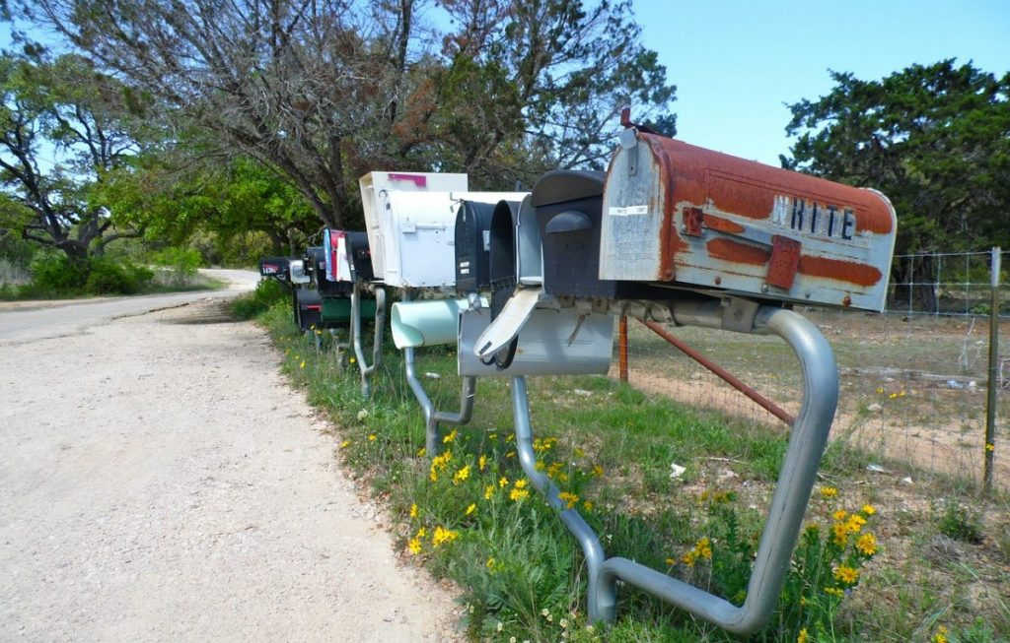
The Circleville Letter Writer
An introduction to Shirley Jackson’s ‘The Possibility of Evil’

Slide 2
The year is 1976..
In the quiet town of Circleville Ohio, residents start receiving mysterious letters…
Many of the letters are of a personal, derogatory, or threatening nature.

Slide 3
Mary Gillespie
Although many people receive these letters, the most threatening ones go to Mary Gillespie
She receives her first letter in 1976
She (a local school bus driver) is accused of having an affair with the district superintendent.
At first she hides the letters because she is married
She hopes the person who is sending them will get bored or just stop.

Slide 4
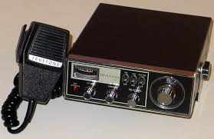
Mary Gillespie
After two letters, the writer sends a letter to her husband Ron. The letter says that if HE does not stop the affair, there will be consequences.
Mary denies the affair to her husband.
The letters are often incoherent and don’t make a lot of sense.
The letter says: (LETTER 1)
- I KNOW WHERE YOU LIVE - I KNOW YOU HAVE CHILDREN - I’VE BEEN WATCHING YOU
- STOP THIS BEHAVIOUR OR YOU’LL REGRET IT.
By the 4th letter, the writer is threatening to put the truth on CB radios, posters, signs and billboards (pre internet)

Slide 5
DISCUSS #1 If you had to guess at this point (with almost no suspects) who do you think the Circleville Letter Writer is?

Slide 6
Three people know about the letters to Mary…
1) Ron’s sister Karen
2) Karen’s husband Paul
3) Paul’s sister
The five of them get together and write 5 letters to the person Mary suspects of being the writer
… No more letters are received for a few weeks.

Slide 7
On Aug 19th, 1977…
Ron gets a threatening call.
We don’t know the content; but, it is assumed that Ron knows the voice.
Ron grabs his shotgun and immediately takes off in his car.

Slide 8
Ron’s car crashes into a tree and he dies.
The police will later discover that his blood alcohol was twice the legal limit at the time.

Slide 9
Those that knew Ron, claimed that he was not a drinker…
His family said that he did not appear drunk.
Many people argued that his death was mysterious because it was so close to home and he should have know the area.
Fact: most accidents occur within 5km of the home because people let their guard down.
It is also noticed that his gun has been fired once recently. It is unclear what the circumstances were. The shell is never found.

Slide 10
DISCUSS #2: What do you think happened to Ron?

Slide 11
In the town…
Letters begin going out saying that the sheriff is covering up the murder of Ron. The letters say that he was run off the road.
Mary admits to the affair (She claims is started AFTER the letters went out…)

Slide 12
February 1983
Signs appear on Mary’s bus route that are talking about Mary and her daughter.
Mary takes a sign down. There is a box and string attached to it…
She opens it. There is a gun and a booby-trap. When she took the sign down the string should have pulled the trigger and shot her through the box.
She takes the gun to the police.
The serial number has been rubbed off but they are able to figure out the owner…

Slide 13
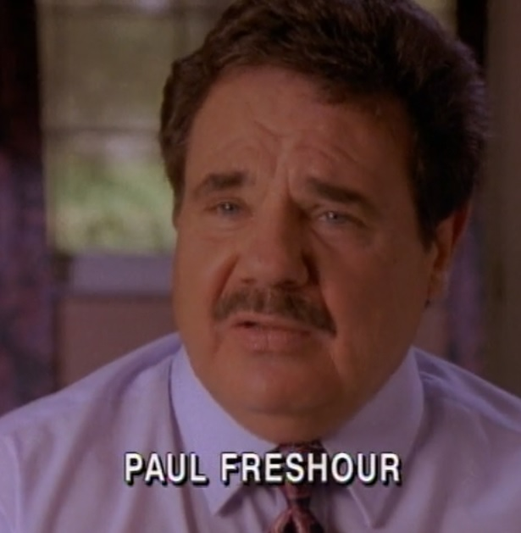
MARY’S BROTHER IN LAW, PAUL

Slide 14
Paul…
Is now divorced from Karen
He says that the gun had been stolen
He says he doesn’t know when it happened because he kept it in the garage.
He had the day off on the day Mary found the box
He gives hand writing samples
He is given the letters and is told to copy them to see if his hand writing matches.
They say the sample matches.

Slide 15
DISCUSS #3: Do you think that Paul did it? Why or why not?

Slide 16
October 24th, 1983 (7 years after the 1st letter)
Paul is taken to trial
He has an alibi (many friends and family place him elsewhere).
The court brings in 39 letters from between March 27th 1976- Dec 23rd 1982 (they say he wrote them).
The judge will not let Paul take the stand in his own defense. If he does, the prosecution will be allowed to bring in 1000 letters as evidence.
The letters make Paul look like a “psychotic stalker”
The only evidence tying Paul to the case is the gun.

Slide 17
The trial lasts four days…
Paul is found guilty of the attempted murder of Mary Gillespie
He is sentenced to 7-25 years in prison
The sheriff says that even if the letters weren’t him, the gun was.

Slide 18
DISCUSS #4: Did Paul do it? Did he get a fair trial?

Slide 19
After the trial?
A private investigator later finds a woman that claims that she had seen a man with Paul’s gun the day before the attempted murder.
The police say that she never mentioned this and it isn’t true.
Paul goes to jail

Slide 20
And the letters continue…

Slide 21
They are being sent from Columbus
The prison is accused of not controlling Paul properly
The warden does an investigation from the prison
They put Paul in solitary confinement
The letters keep coming
The warden thinks Paul is innocent
The sheriff thinks Paul is guilty
Paul is denied parole 7 YEARS LATER because he has not stopped writing the letters or confessed to his crimes.

Slide 22
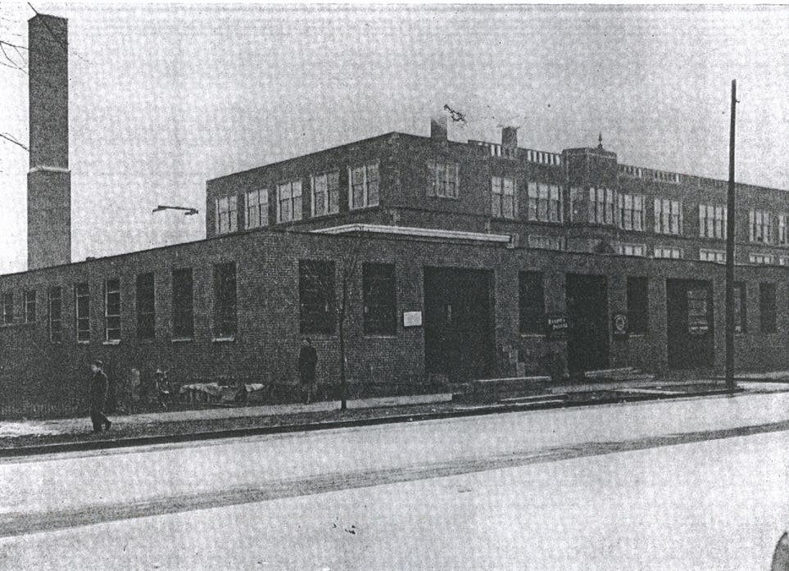
1990…
Paul gets a letter in prison: (LETTER 2)
“When will you stop believing that you will be able to get out of this? I told you two years ago. When we set them up, they stay set up”
… Paul is in prison for may more years…

Slide 23
Down the line…
An investigative reporter finds out that a bus driver that drove past to booby-trap 20 minutes before Mary, saw a yellow El Camino with a tall man with sandy hair next to it.
This is not Paul
It sounds like Paul’s ex wife Karen’s new boyfriend

Slide 24
March 1993
Another town gets letters that appear similar to the originals.
They say that Mary is the original letter writer
They also claim to know the killer of another local murder.
The victim of this murder was also having an affair.

Slide 25
Paul gets parole in 1994… (After 11 years in prison) …Paul Passes Away in 2012
The television show, Unsolved Mysteries runs an episode about the writer.
The network starts getting threats from a mysterious writer with the M.O. of the original writer (LETTER 3)
The letters stop in the mid 90s

Slide 26
Suspects..
Mary
Superintendent's wife and son
Paul and a partner
Another bus driver named David Longberry who was interested in Mary (on July 11th 1989 he went on the run after raping a young woman). He was found dead around the time the letters stopped.
Paul’s wife Karen and her boyfriend (Paul got almost everything in the divorce. When he went to prison, she got it all: kids, house, everything).
The sheriff
A series of copycats?
A mix?
Someone else?
Keep in mind the letters and motivations change over time…

Slide 27
DISCUSS: Who is the Circleville Letter Writer? Write a persuasive paragraph giving proof and examples to your claim.

Slide 28
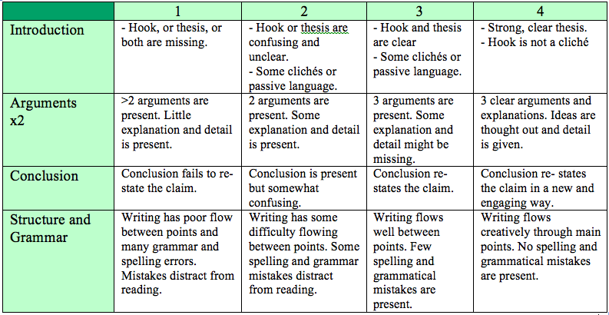
Rubric

Slide 29
You can listen to this story in more detail on the Generation Why Podcast
http://thegenerationwhypodcast.com/circleville-letter-writer-267-generation-why (47.59 mins)

