Slide 1
5-Paragraph essays

Slide 2
The parts of the essay
Introduction
Body 1
Body 2
Body 3
Conclusion

Slide 3
Introduction Paragraph – set the tone
Hook – how will you engage your reader?
Have something that gets your reader to “bite”
Ex. historical context, personal anecdote
Overview – briefly introduce your topic
Ex. “Despite the overwhelming scientific evidence, only 51% of Canadians believe that climate change is a serious issue (Pew Research, 2015).”
Thesis – your argument’s road map
Example last sentence of paragraph: “In this essay, I will argue (first paragraph), (second paragraph), and despite (information to the negative), (third paragraph).

Slide 4
Body Paragraphs – show your stuff
No more “I” pronouns – you are strictly reporting the facts
Present the information, and explain what the information means
Give strong examples, details, and explanations that support your point
**Organize your paragraphs in the order your talk about them in your thesis!**

Slide 5
Conclusion Paragraph – bring it home
Restate you’re a condensed version of your thesis
“In this essay, I argued for…”
Briefly summarize the main point of each of your paragraphs
End strong: the “so what”
What implications do the results of your research have on humanity?
“Based on the research in this essay, it is my strong conviction that we need to reject Mini Pop Kids and embrace Kidz Bop as the one true tween cover-band sensation.”

Slide 6
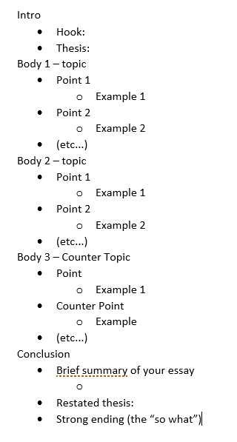
outline
Outlines really help keep your essay organized and clear

